Slide 1
PREDICTING DIABETES PATIENTS

Slide 2
INTRODUCTION
The data mining process framework used is the CRISP DM process. There are 6 steps involved in the CRISP Data Mining process:
Business Understanding
Data Understanding
Data Preparation
Modeling
Evaluation
Deployment

Slide 3
TASKS IN DATA MINING PROCESS
Prior knowledge: This step in the data mining process aids in defining the problem we are trying to address, how it fits into the larger corporate context, and what data we will need to do so. Data mining reveals hidden patterns within the data set. It reveals numerous patterns. False signals are a significant issue in the procedure. Therefore, understanding the subject is crucial. There is prior knowledge in the data, just like there is prior knowledge in the subject. In a normal enterprise, data is typically acquired as part of business processes. The data mining process requires an understanding of how the data is gathered, stored, converted, reported, and used.
Preparation: The element of the procedure that takes the longest is preparing the data set for a data mining task. Data rarely exist in the format needed by data mining techniques. A tabular structure with records in rows and attributes in columns is required for the majority of data mining methods. In the event that the data is in another format, we must transform the data by using pivot or transpose methods. This method consists of subtasks like: data exploration, data quality, missing values, data conversions, transformations, outliers, feature selection, data sampling.

Slide 4
Modeling: In a given data collection, a model is an abstract representation of the data and its relationships. We must use a previously prepared data set where we are aware of all the attributes, including the target class attribute, in order to create a stable model. The data set used to build a model is referred to as the training data set. We must also check the test data set, which is a different known data set, to determine the viability of the developed model. Seven training records are used to synthesize and generalize the equation-based model. Using a variety of modeling algorithms or training data sets, ensemble modeling is the process of building numerous varied models to predict an outcome.
Application: This is the stage at which the model is "live" or ready for production is deployment or application. The outcomes of data mining, whether a model for predictive tasks, a learning framework for association rules, or a clustering algorithm, need to be integrated into the business process in applications. During the model deployment stage, it is important to evaluate the model's readiness as well as its technological integration, reaction time, maintenance, and assimilation.
Knowledge: The method of data mining offers a framework for obtaining nontrivial information from data. In addition to traditional time series reporting or straightforward statistical processing, we need to use sophisticated strategies like data mining algorithms to extract knowledge from these vast data assets. Prior information serves as the foundation of the data mining process, and posterior knowledge—the incremental business insight gained via the process. It is intended to be utilized as a series of iterative, separate phases that support knowledge development rather than as a set of fixed rules.

Slide 5
EMSEMBLE LEARNER MODEL
The ensemble learner will use each individual prediction model to optimize the hypothesis-finding problem, then combine them to create an aggregate model.
By merging various hypotheses into one, for superior models.
Using other methods to match the base models independently by changing the training set's examples.
ENSEMBLE LEARNER BY USING VOTING
The inner subprocess of the vote operator is an ensemble learner that contains a number of basic models.
It is possible to apply various base categorization models to the vote meta modeling operator.
The same training data will be accepted by all of these models, which will then yield unique base models.
the process of adding up all of these base learners' predictions and giving the vote model's majority forecast.

Slide 6
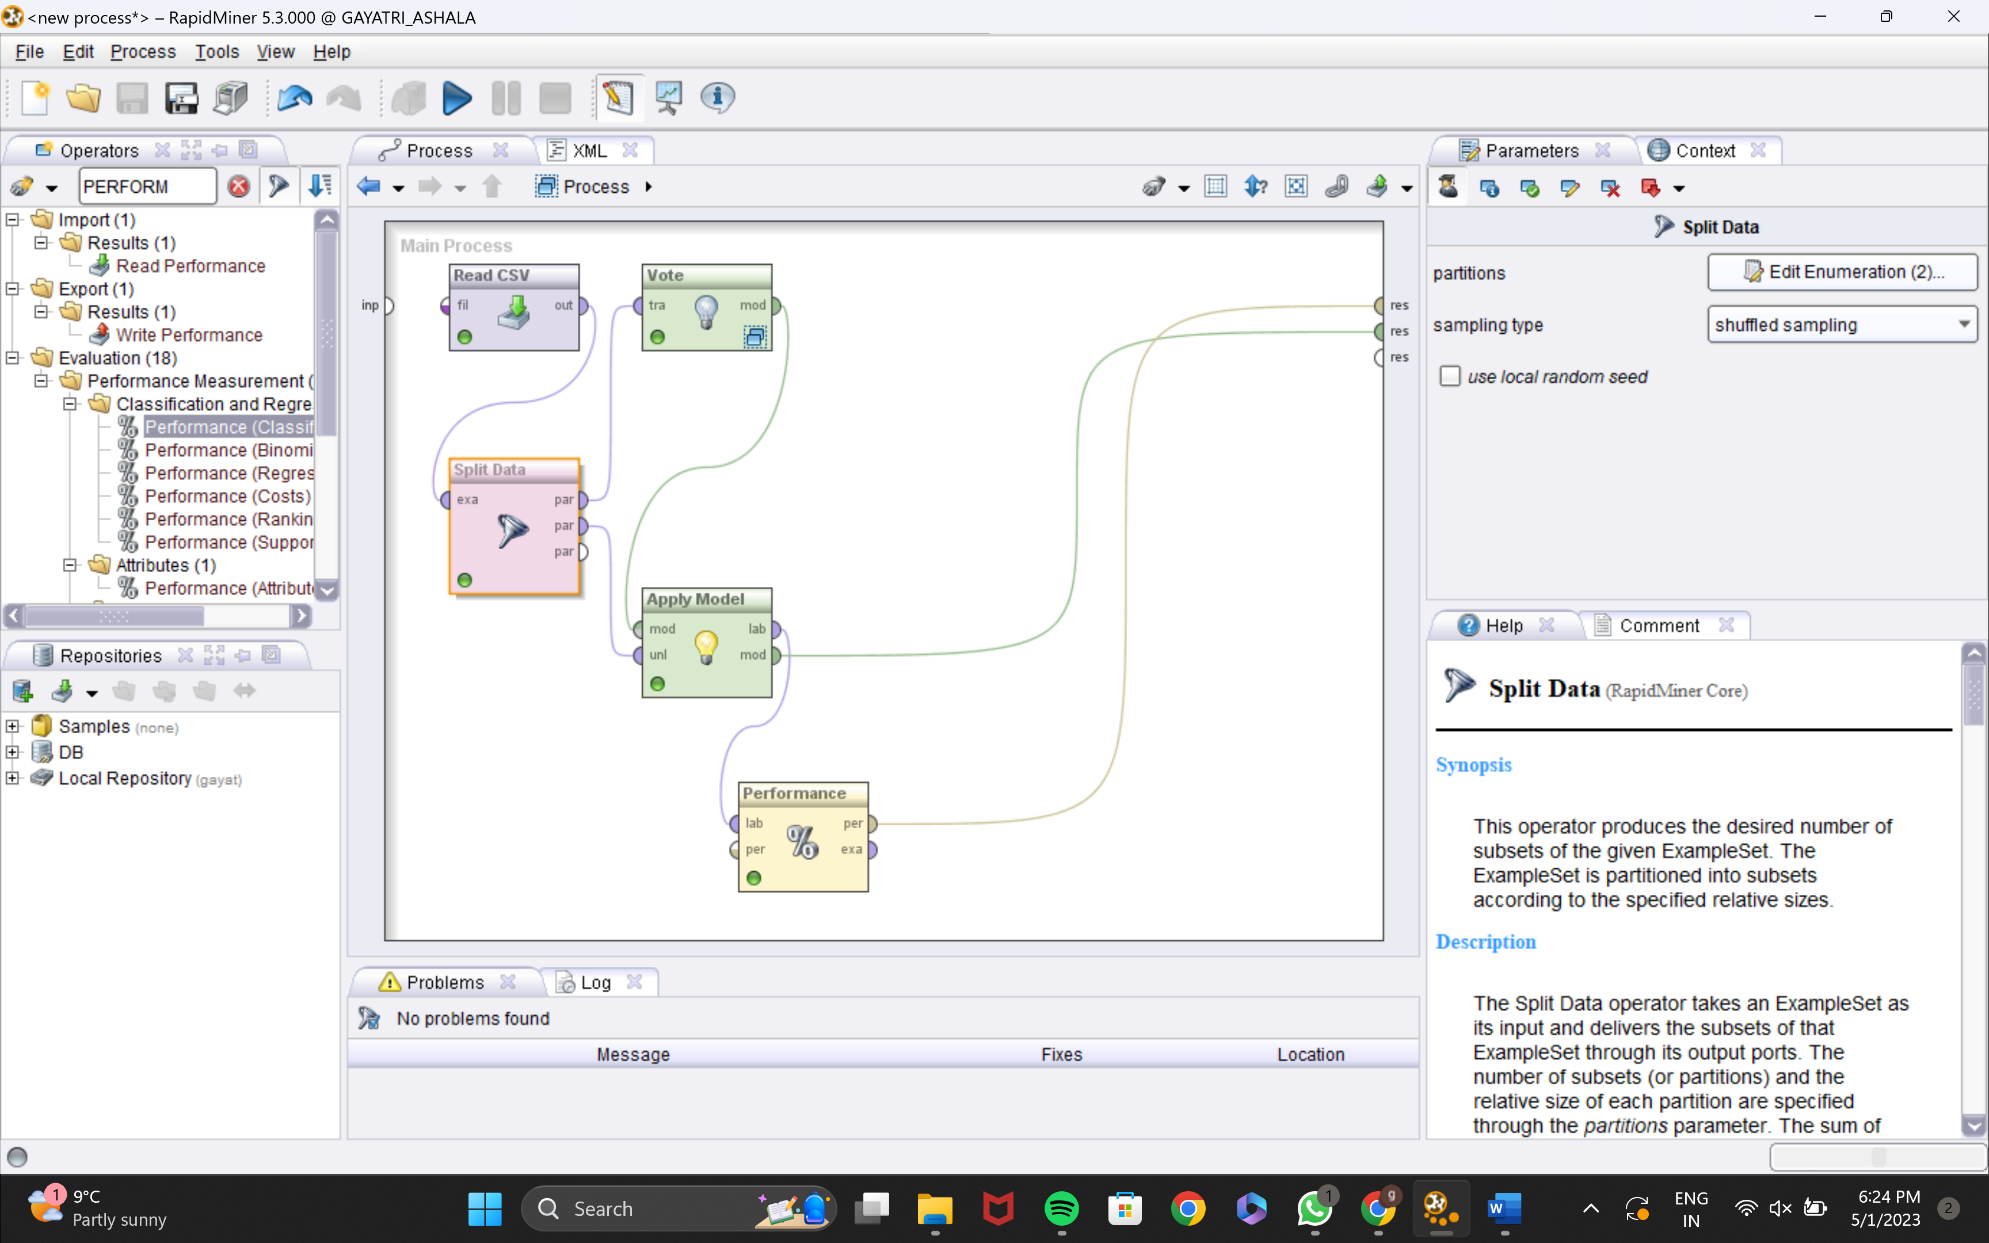
PROCESS

Slide 7
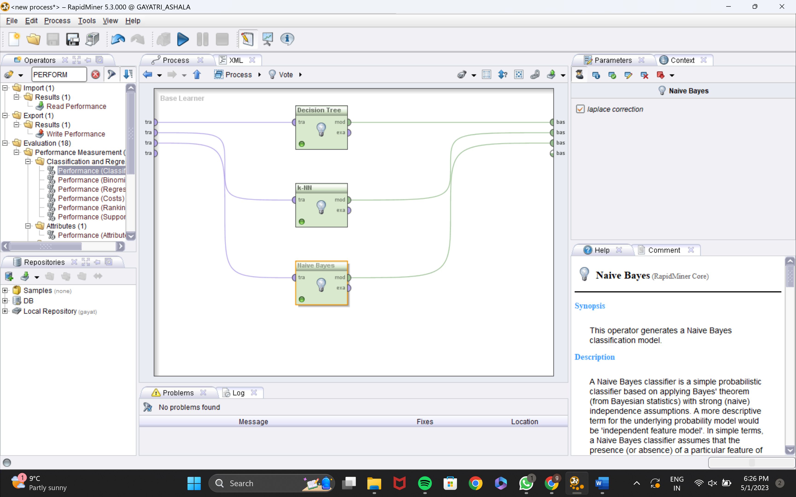
BASE MODEL VOTE

Slide 8
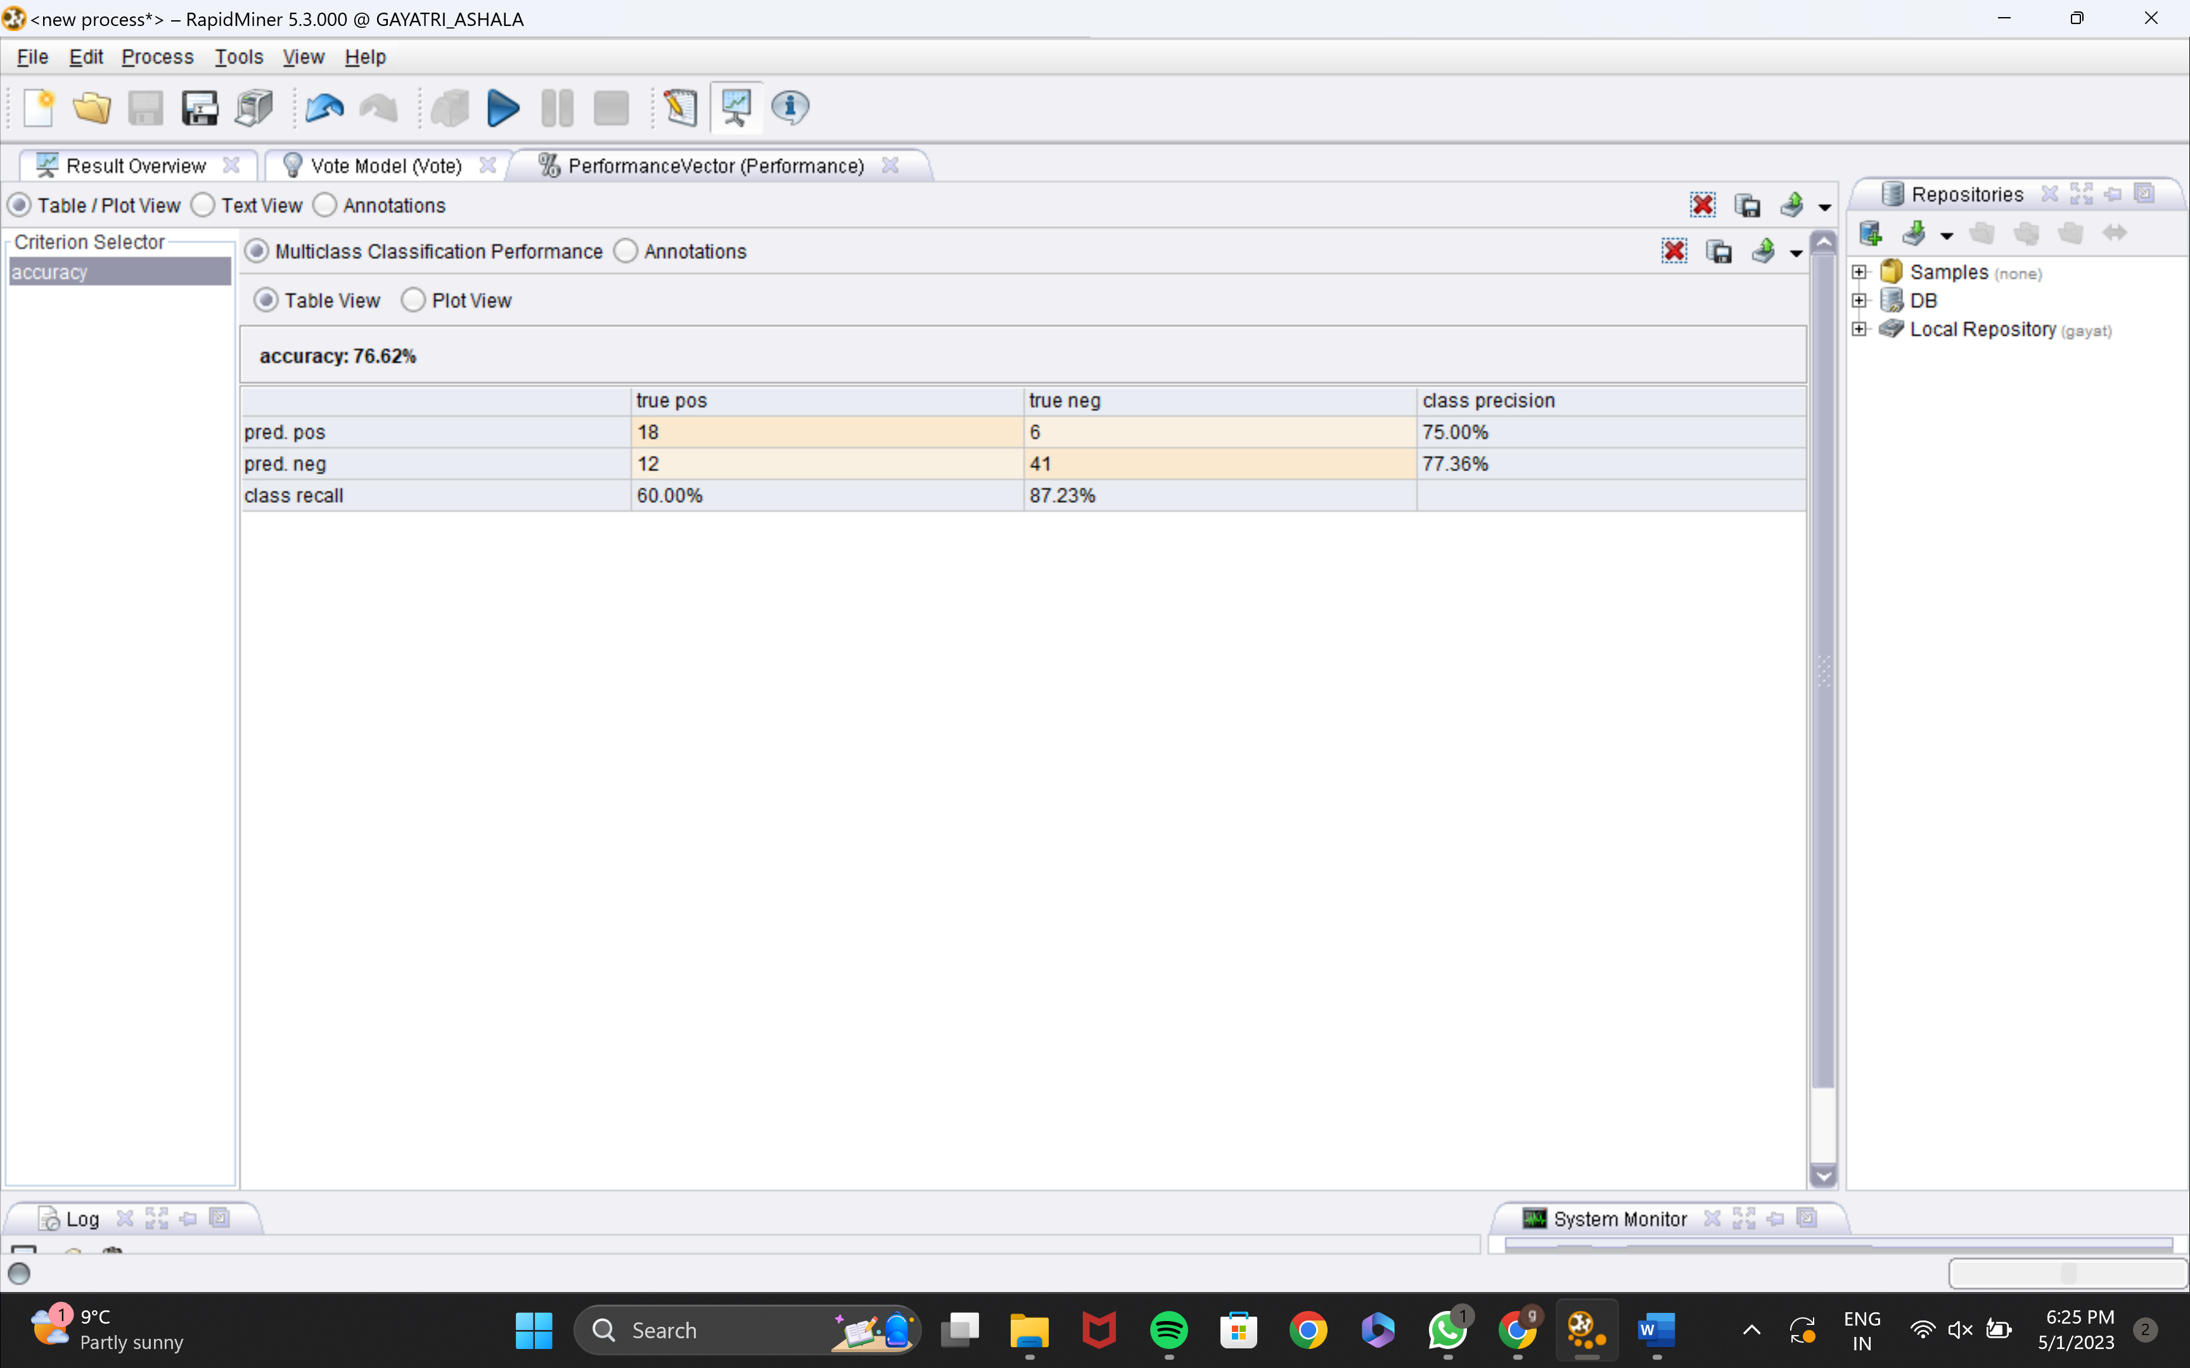
PERFORMANCE

Slide 9
ENSEMBLE LEARNER BY USING BAGGING
Base models are created using the bagging process by altering the training set for each base model.
Bagging is the result of booststrapping and aggregation.
Using sampling with replacement, a training set T of N records and m training sets are created.
The number of records in each training set is the same as in the original. Due to sampling, it can include duplicate records.
Similar to how a vote operator is tested, a bagging operator is as well.
Bagging, however, only uses one model in the subprocess, unlike vote operators.
The output bagging model will function as a single model that has several base models.

Slide 10
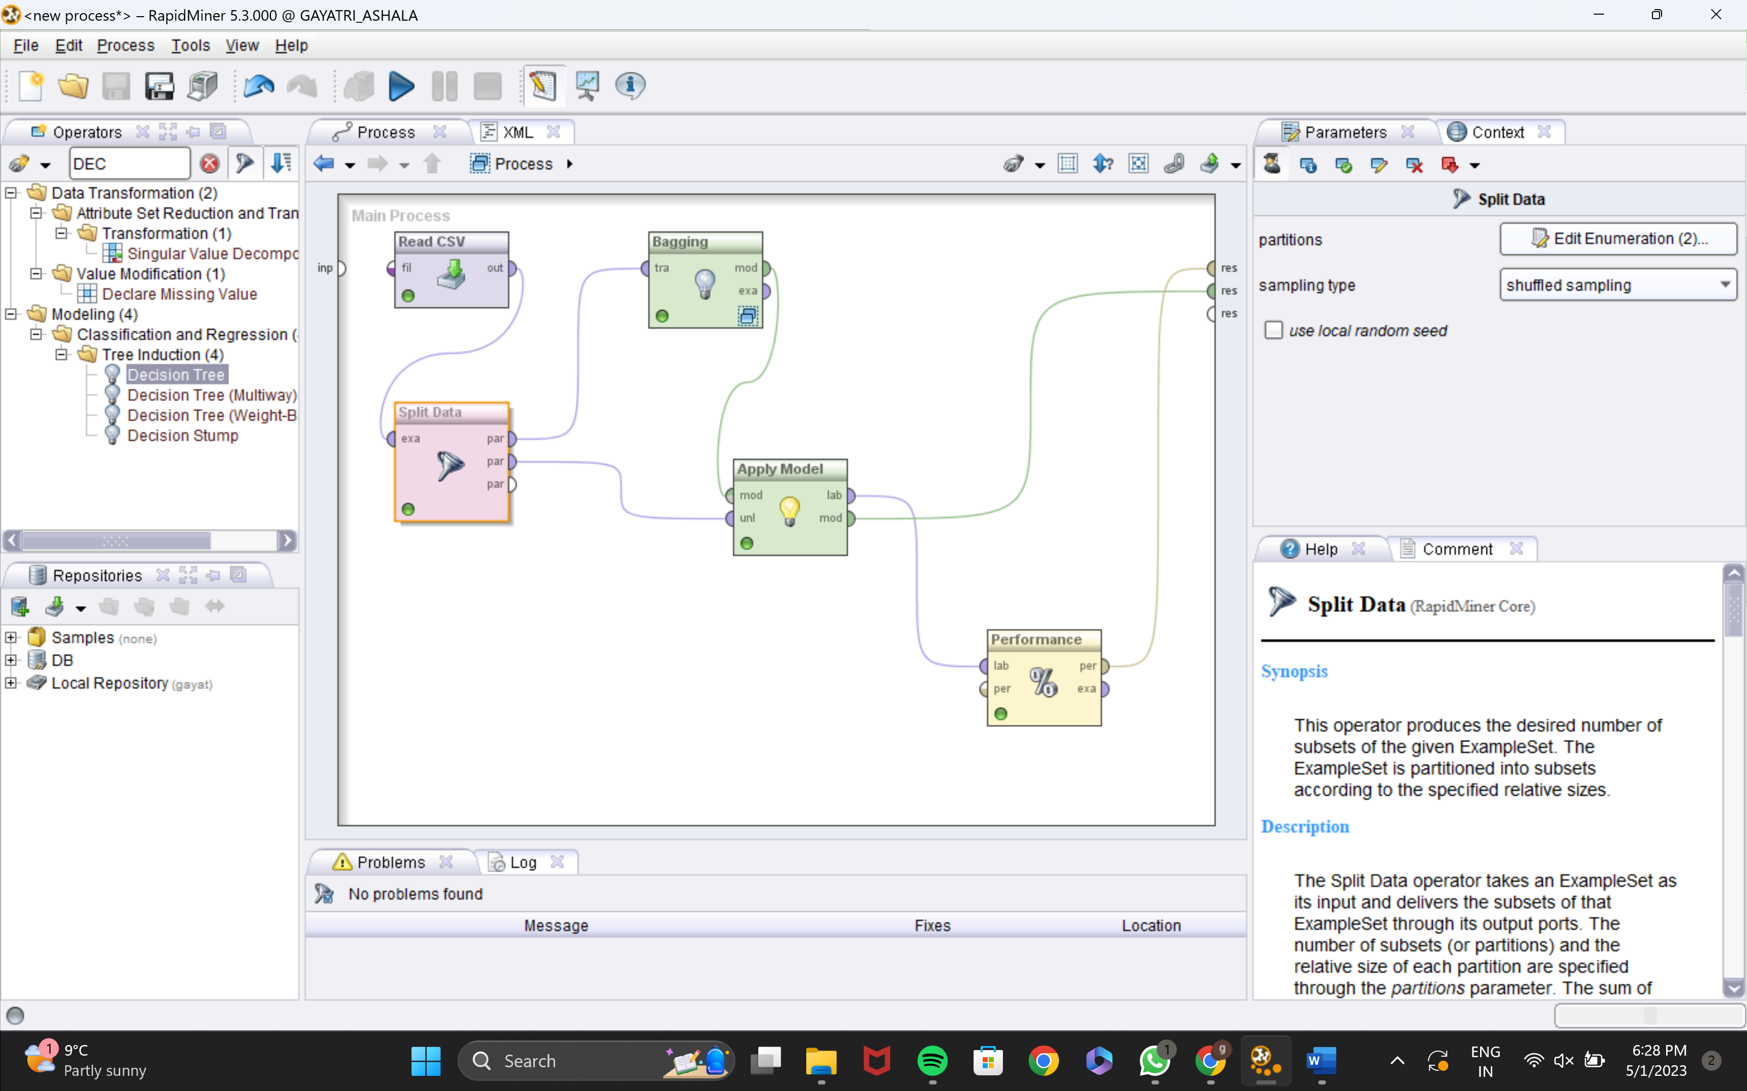
BAGGING PROCESS

Slide 11
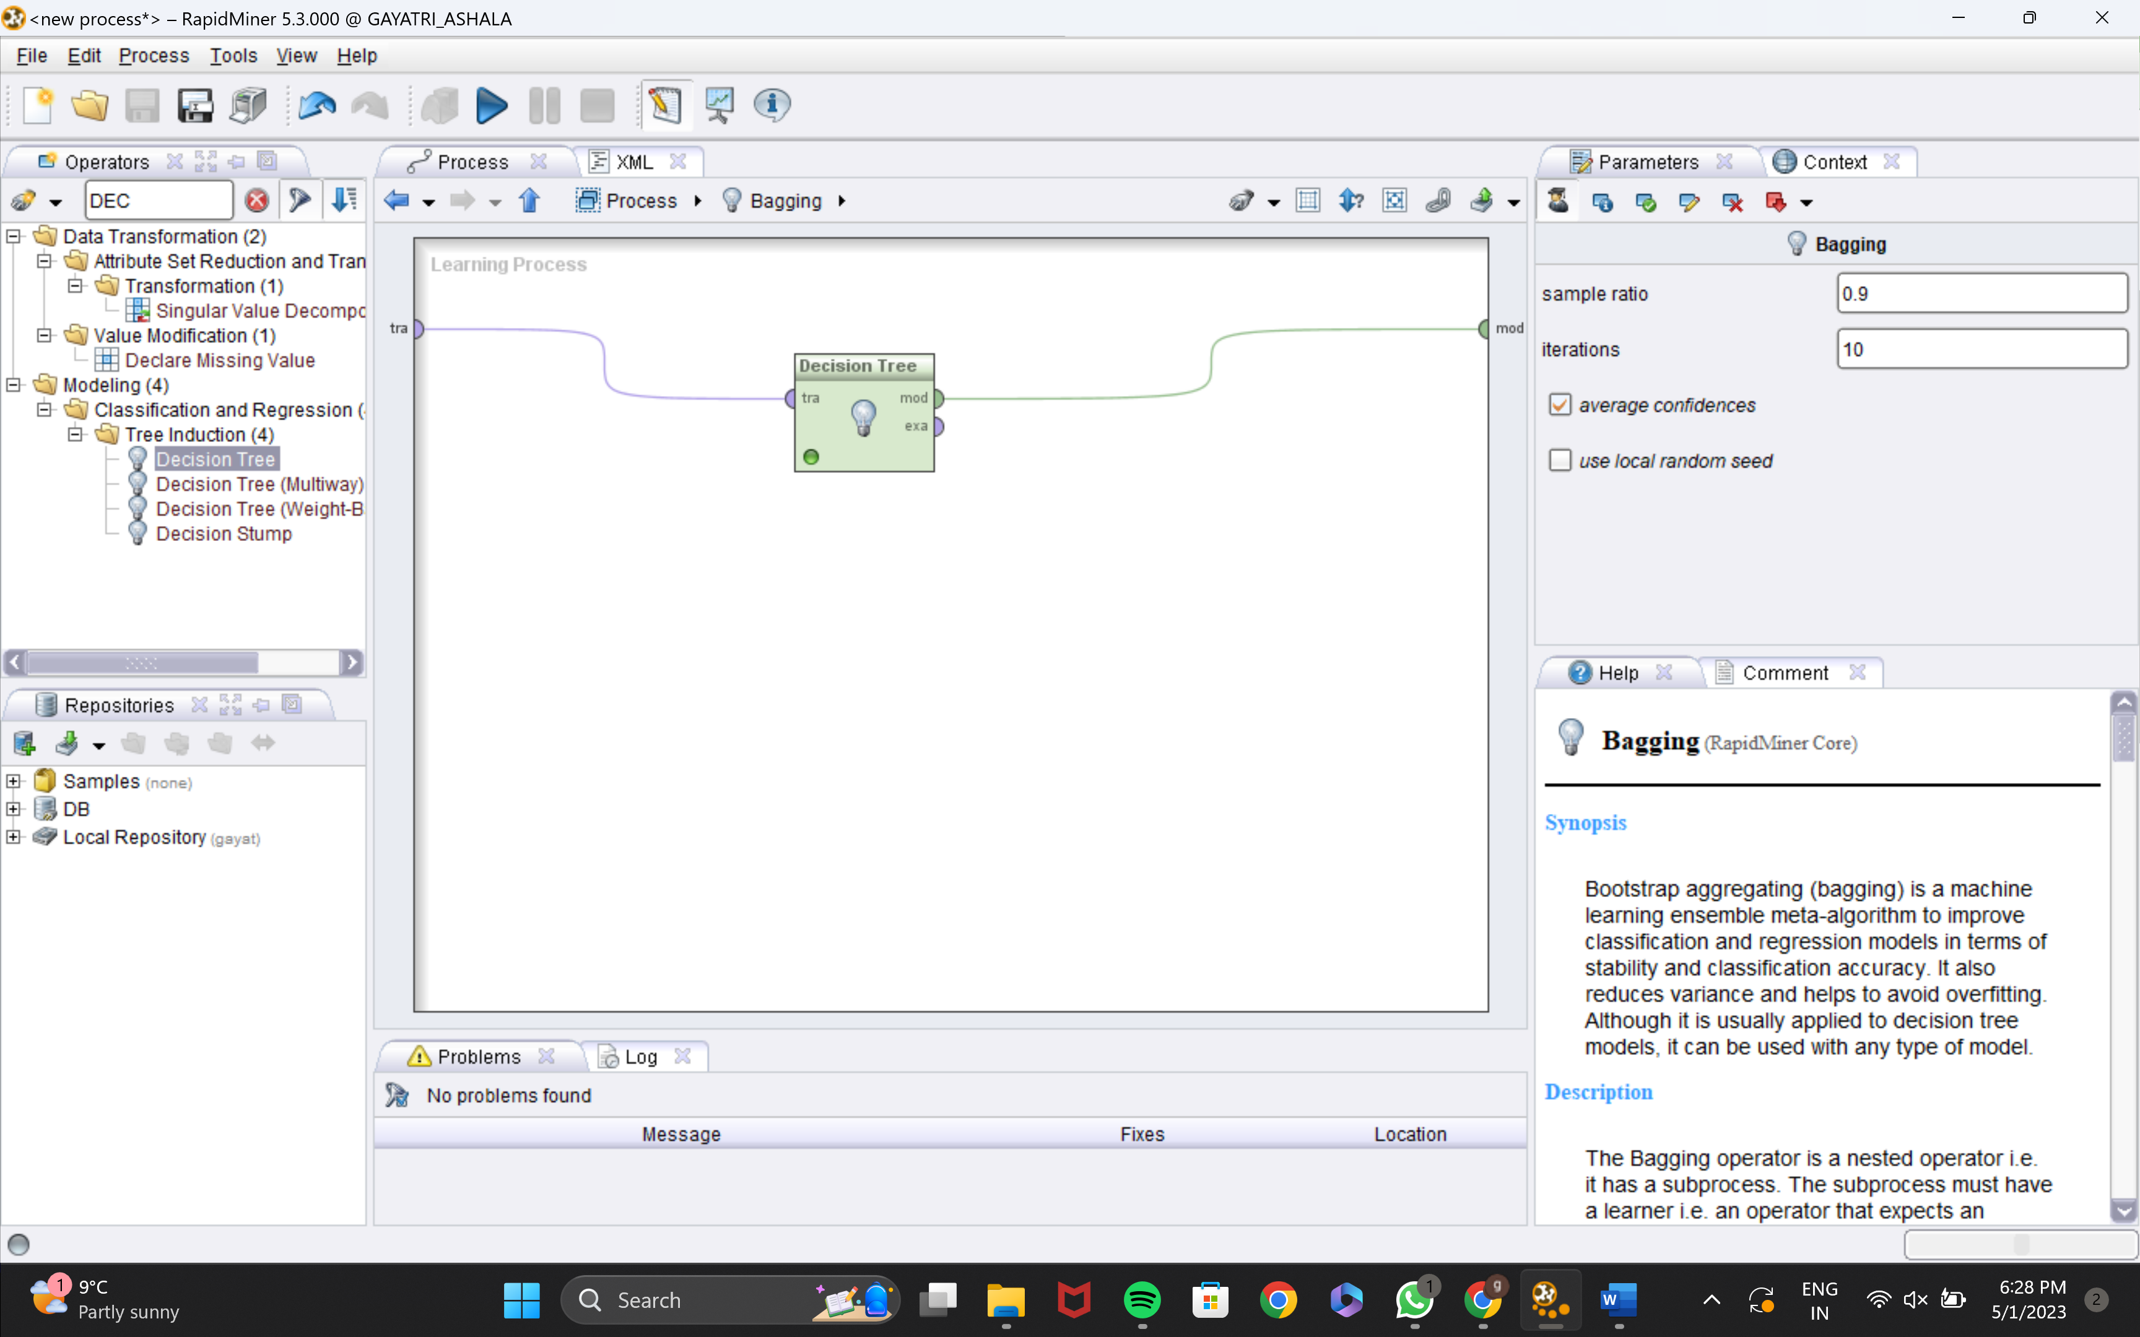
LEARNING MODEL

Slide 12
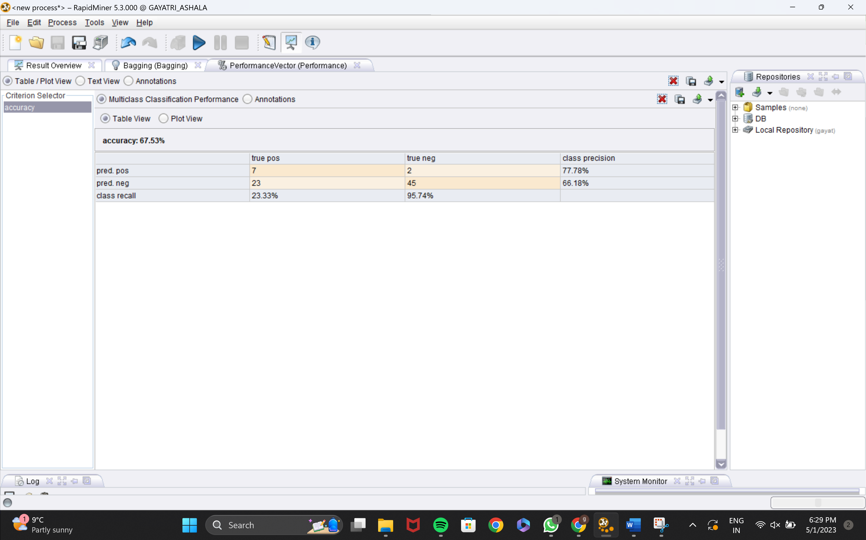
PERFORMANCE

Slide 13
ENSEMBLER LEARNER BY USING ADABOOST
The operator functions similarly to bagging and has an inner subprocess. The number of base models or iterations is a configurable parameter for the AdaBoost opera- tor.
Meta modeling > Classification and Regression > The AdaBoost operator is located in the meta learning subfolder and is called AdaBoost.

Slide 14
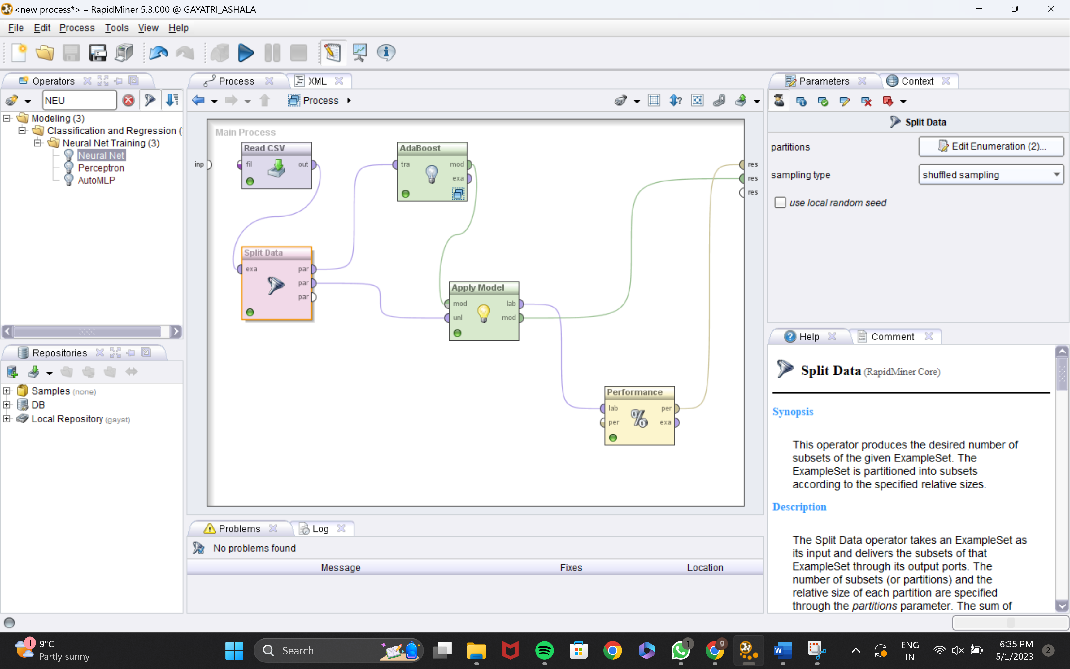
PROCESS

Slide 15
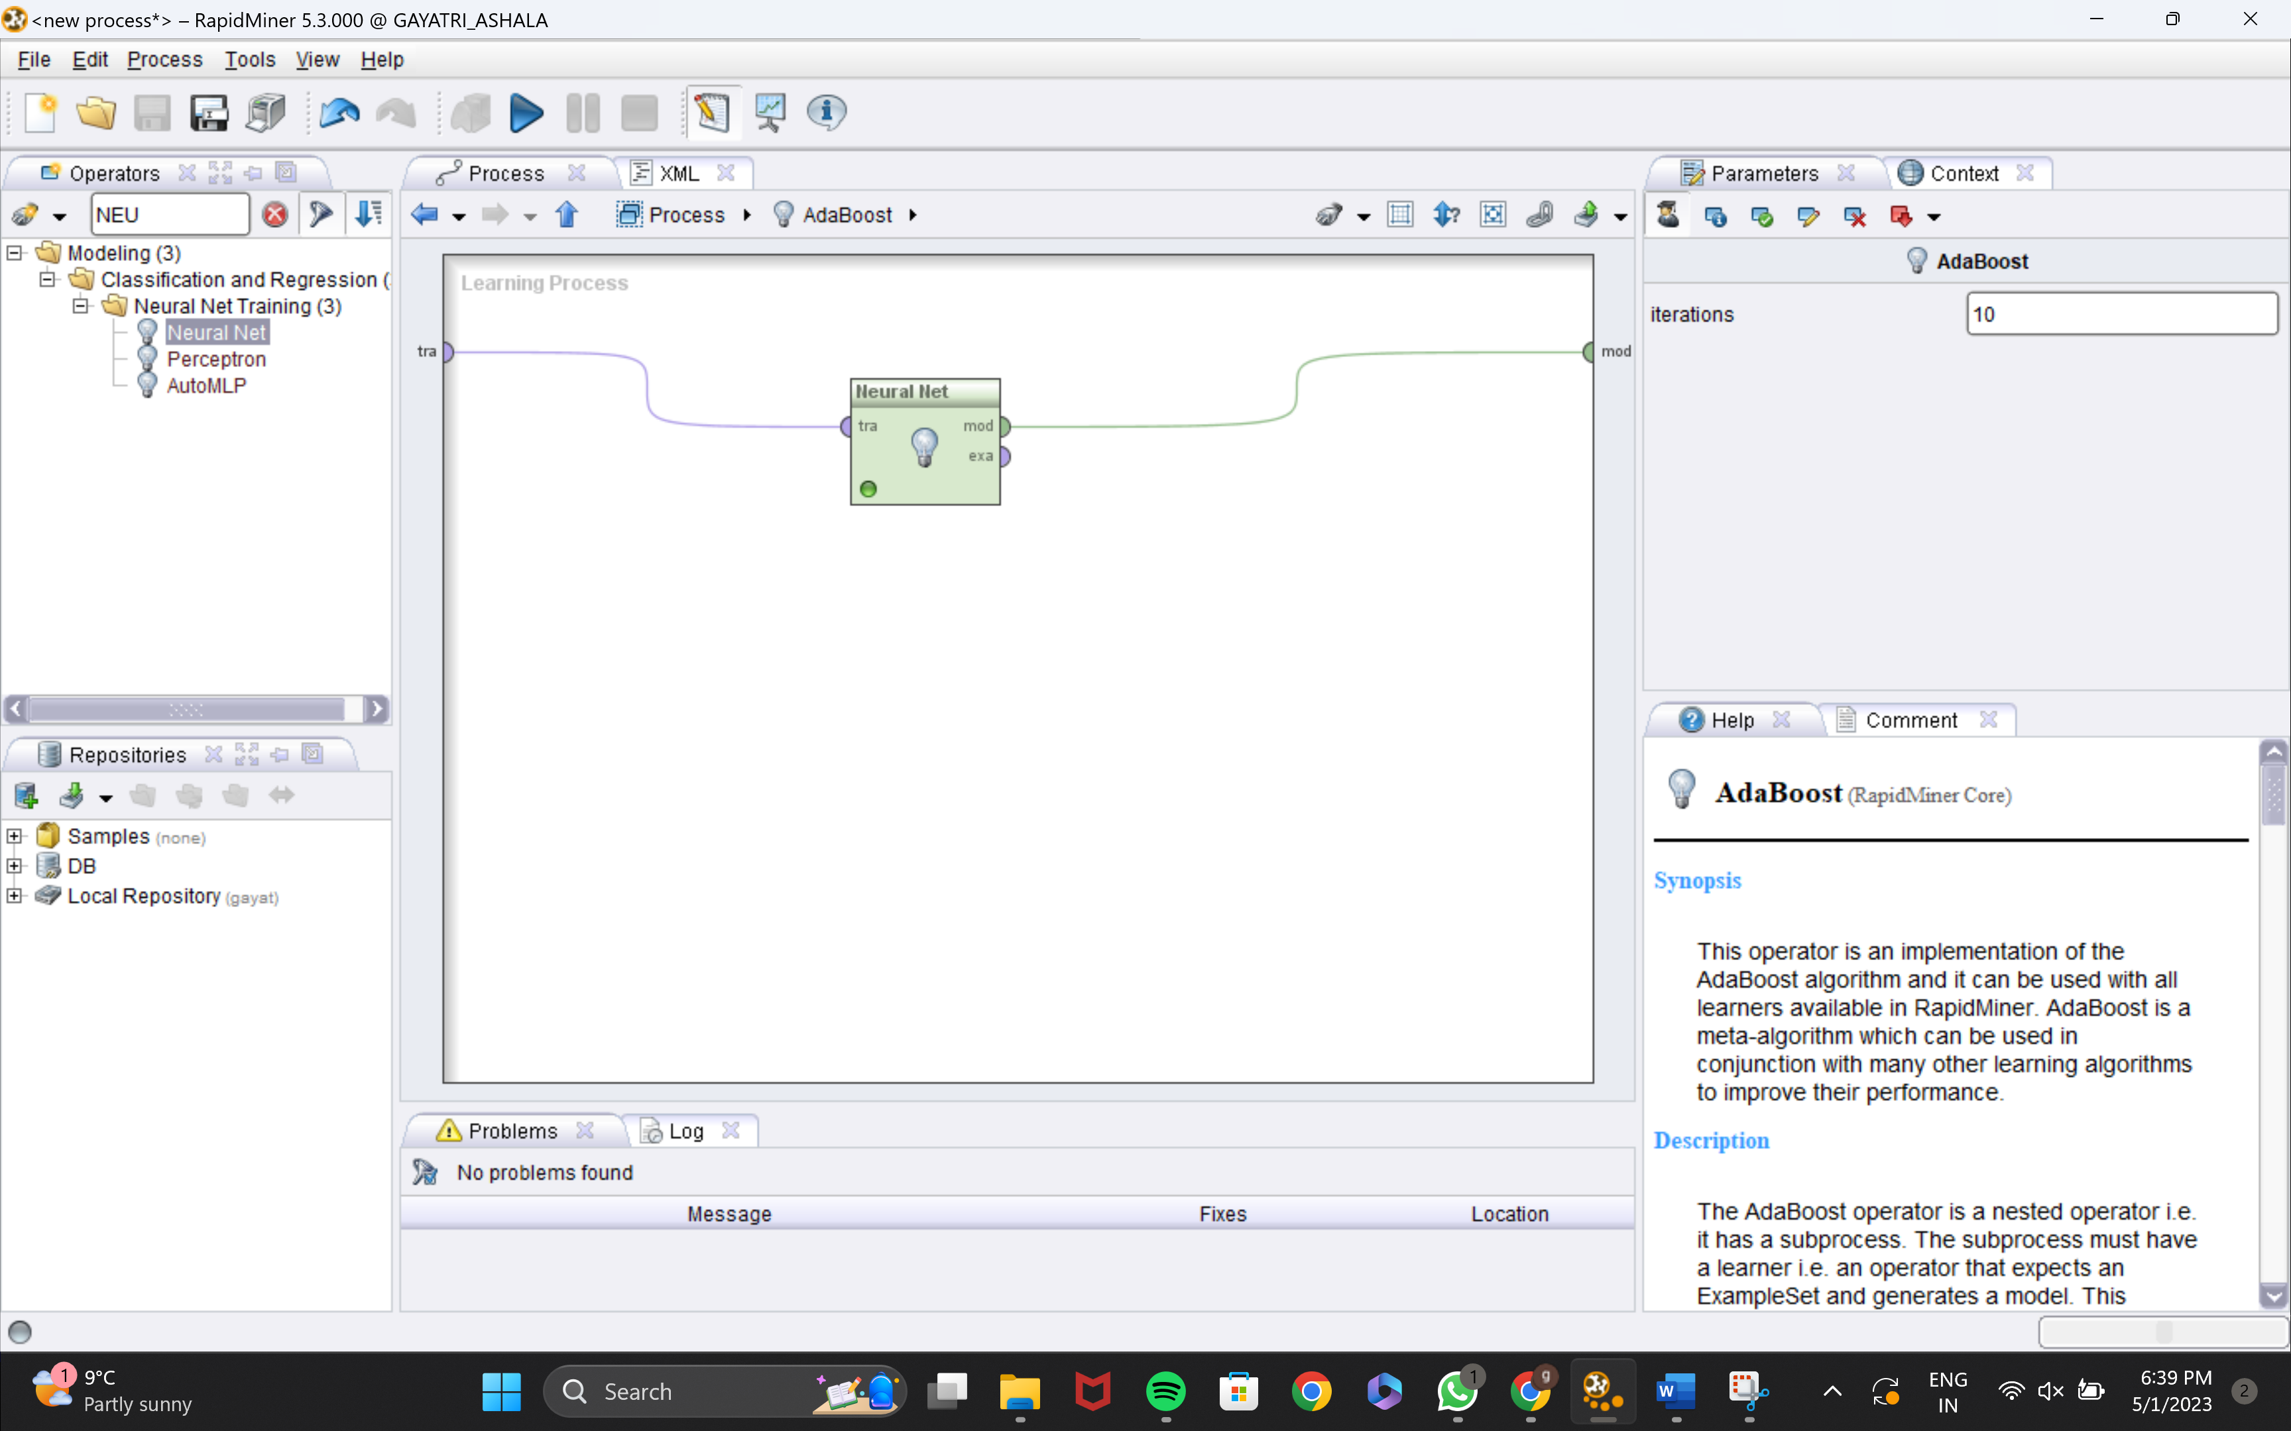
NEURAL NET

Slide 16
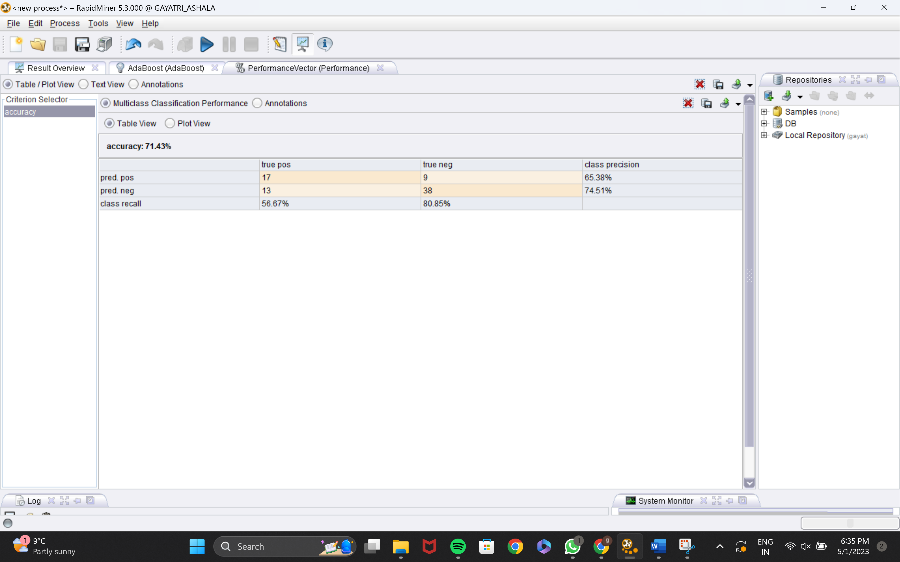
PERFORMANCE

Slide 17
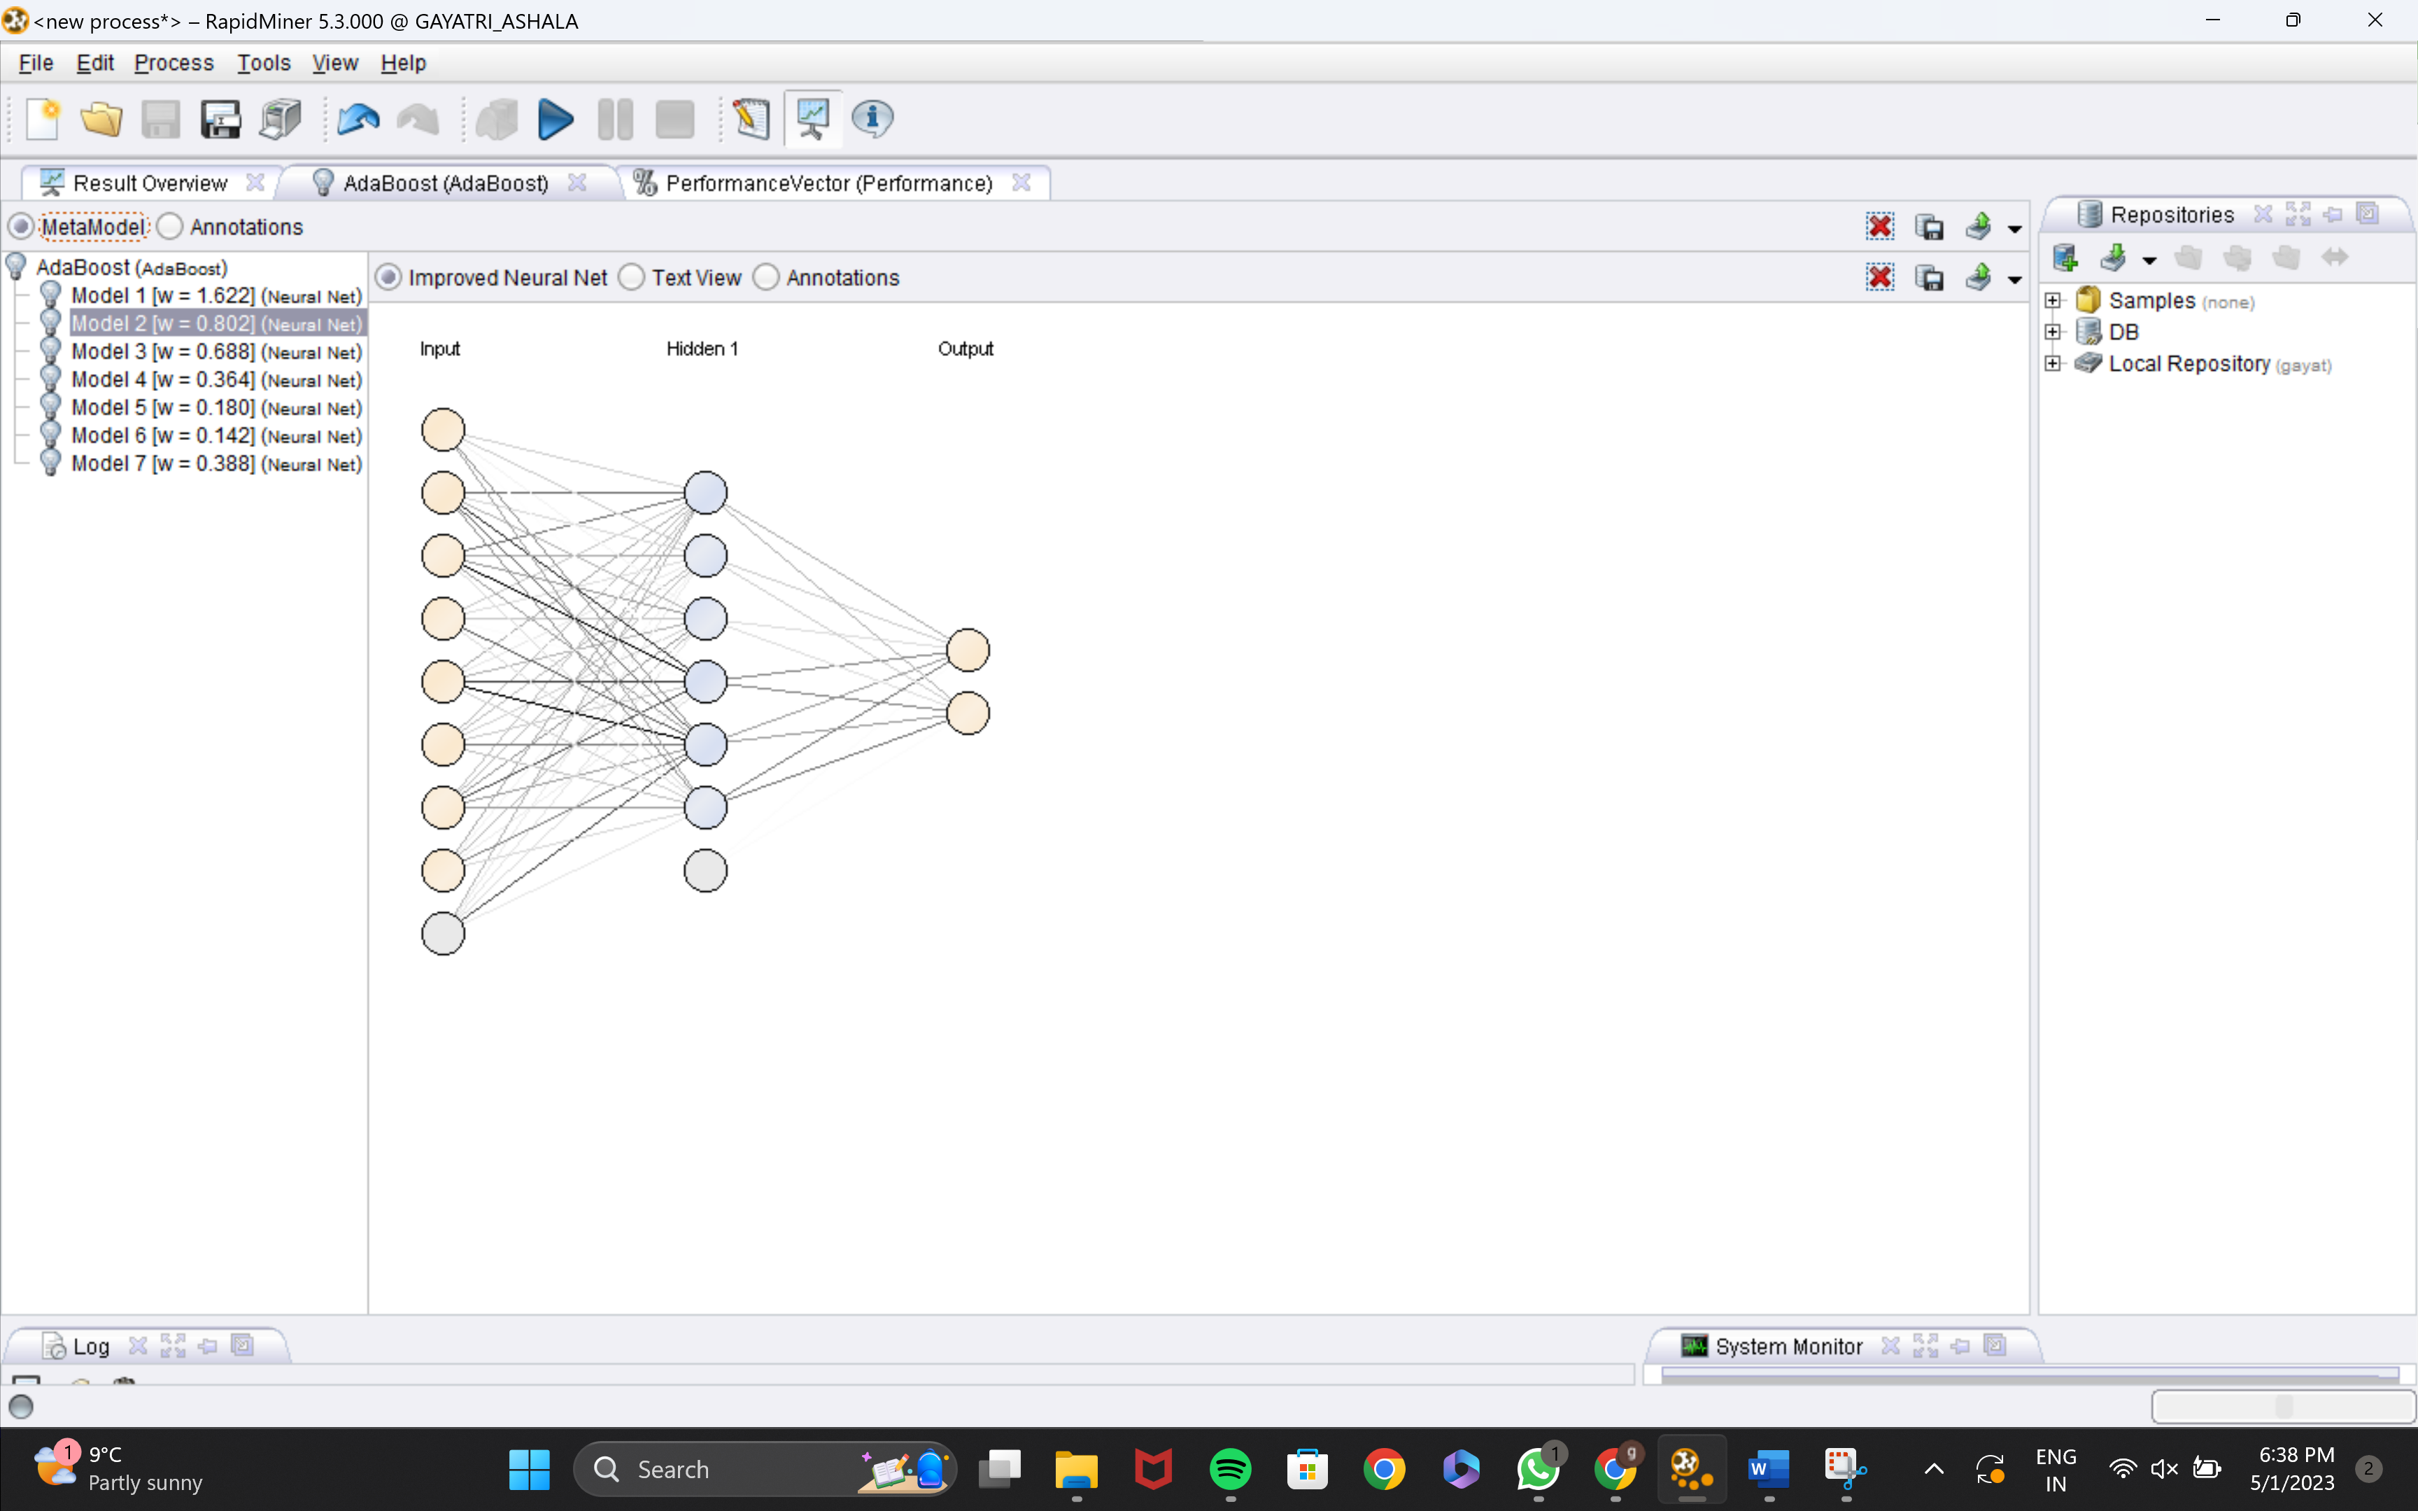
ADABOOST NEURAL NET MODEL

Slide 18
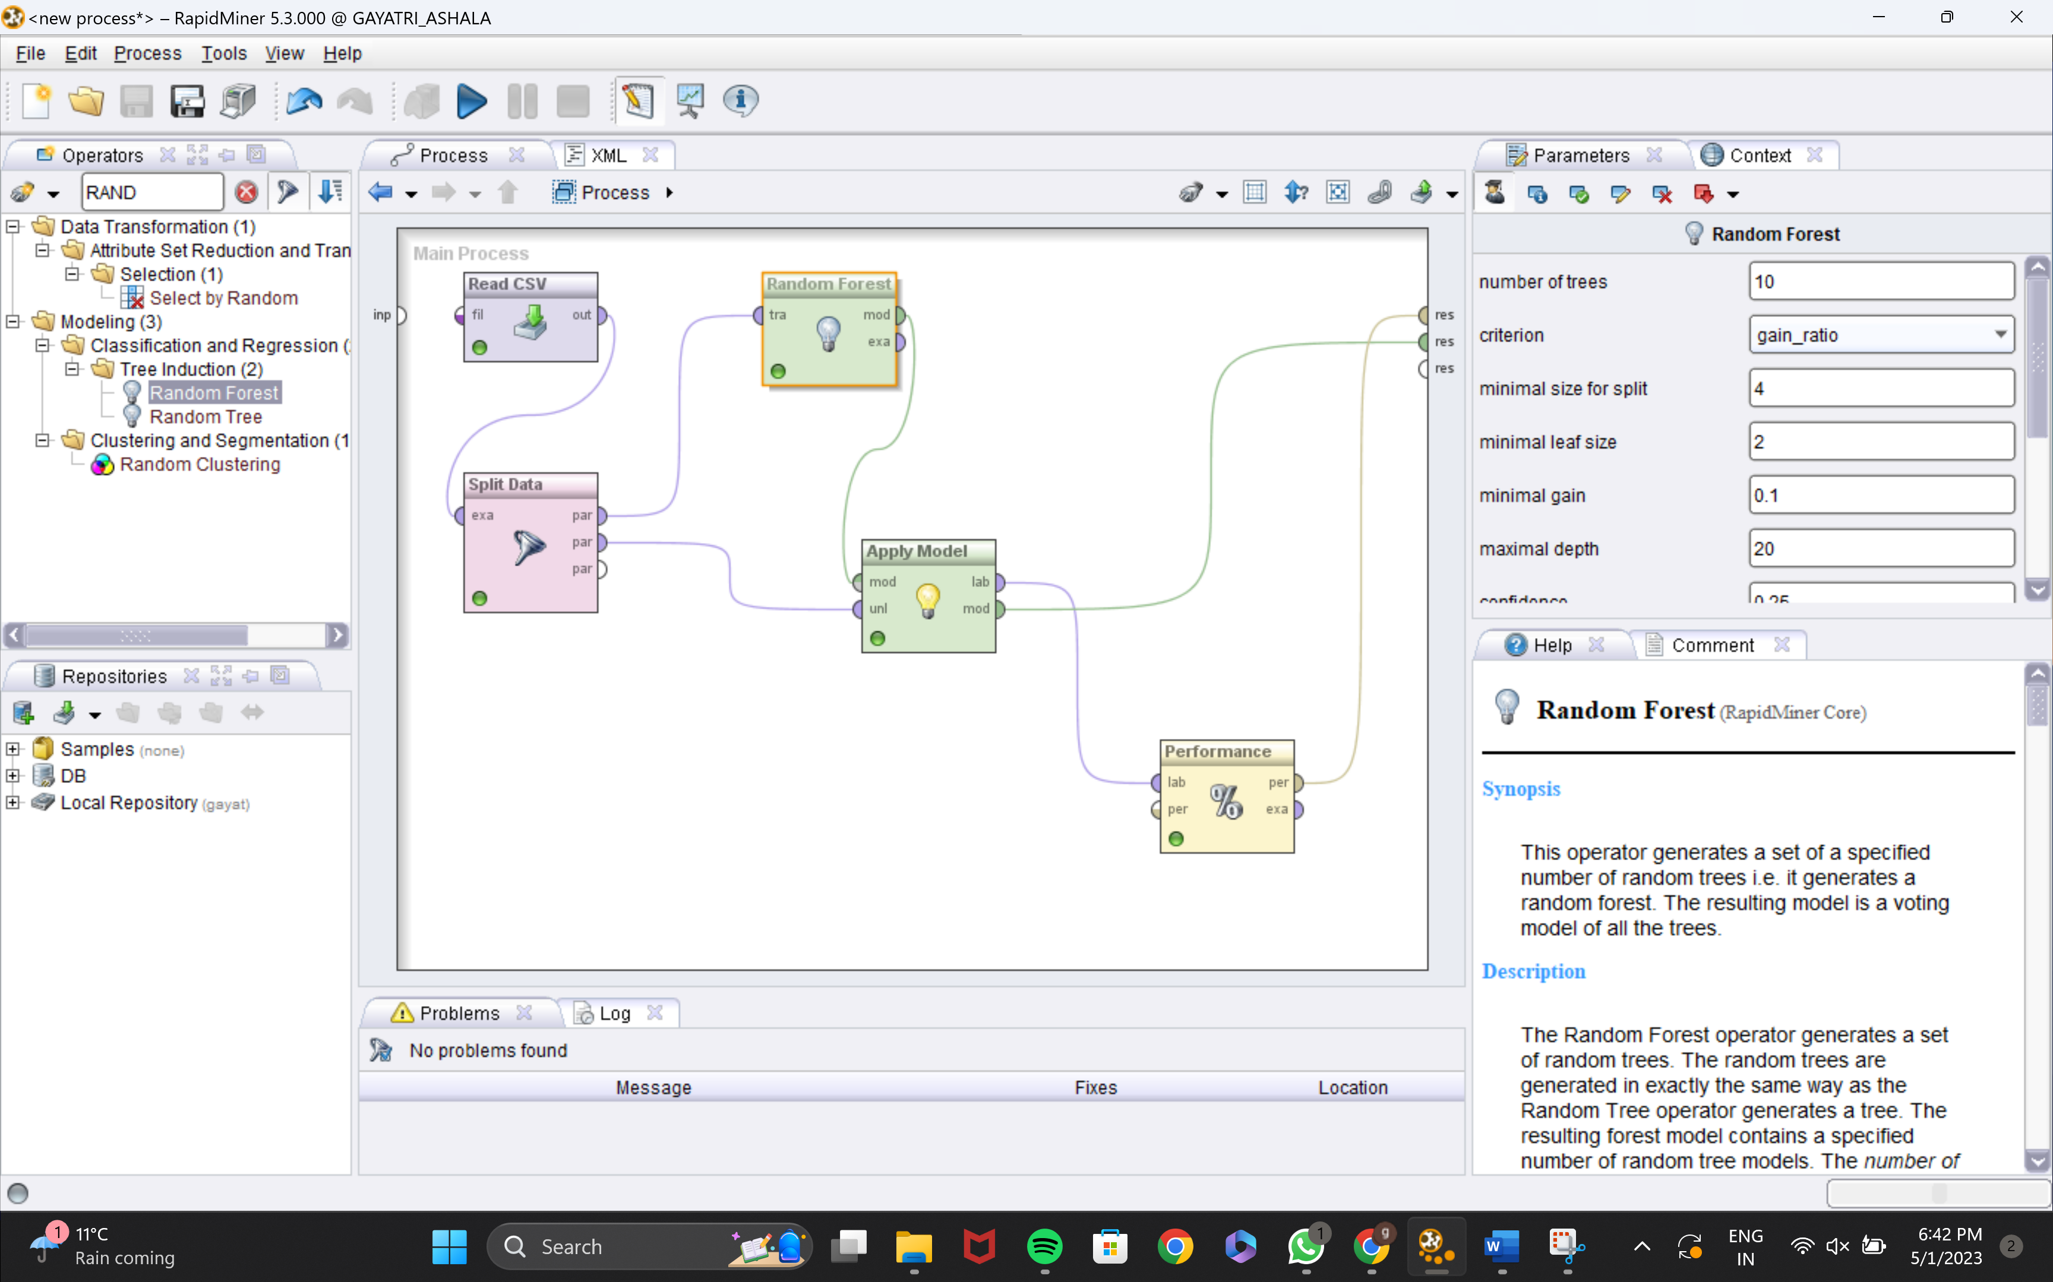
RANDOM FOREST MODEL PROCESS

Slide 19
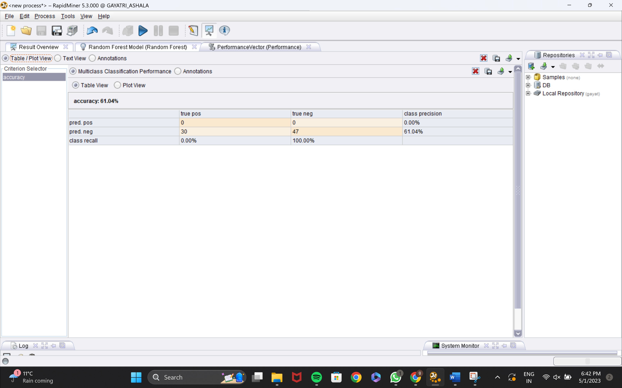
PERFORMANCE

Slide 20
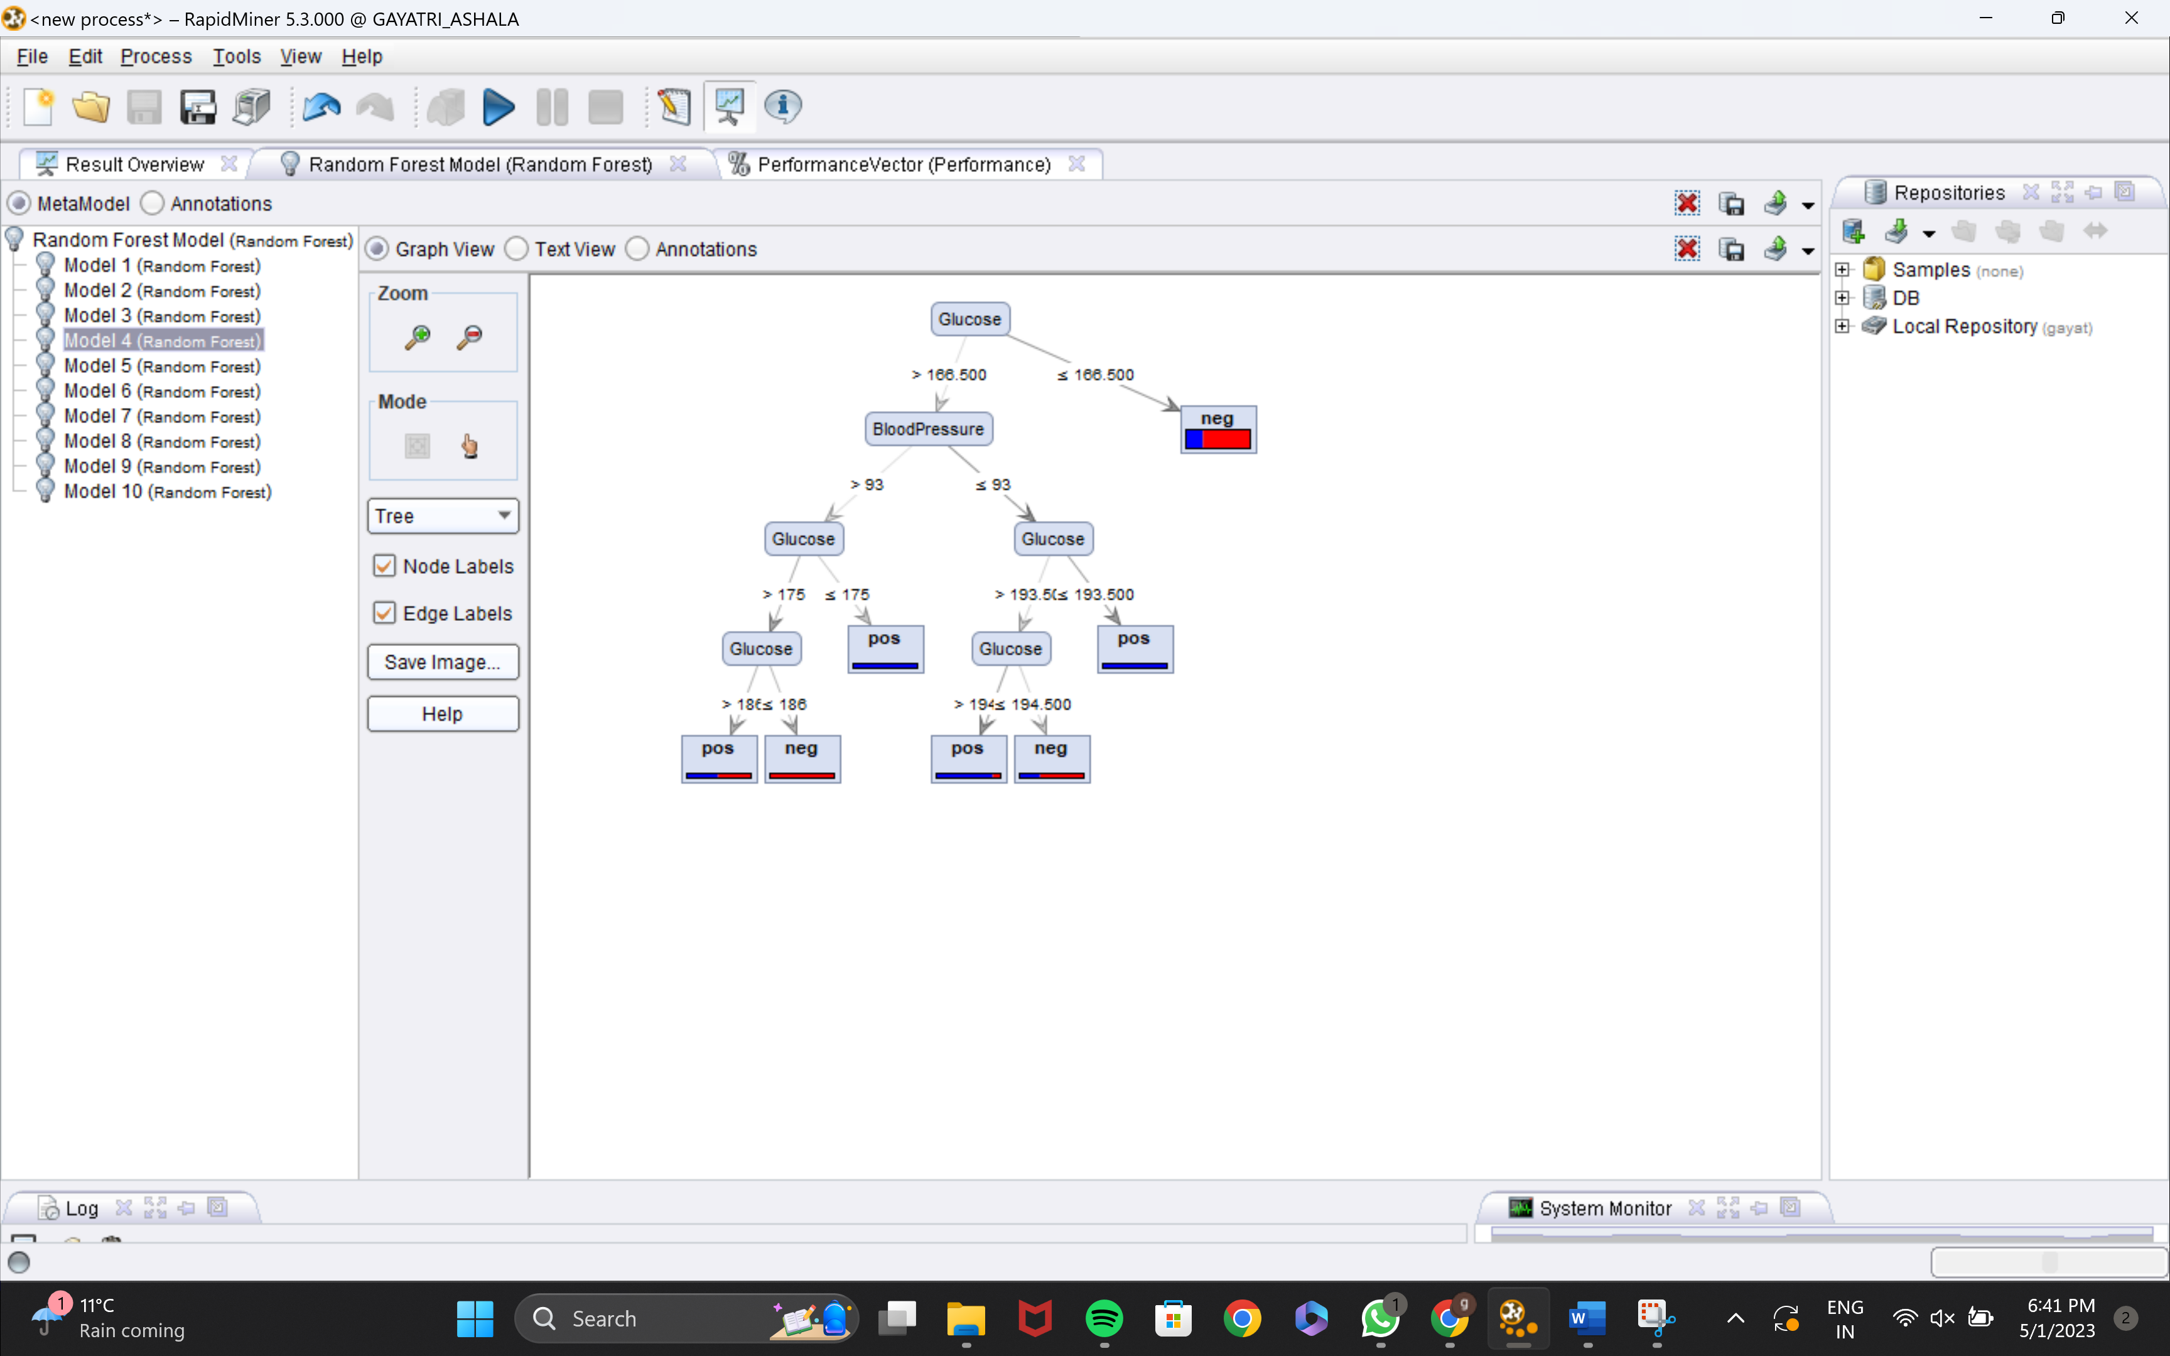
RANDOM FOREST MODEL

Slide 21
K-MEANS CLUSTERING MODEL
The data set is partitioned into k clusters in the prototype-based clustering technique known as k-means clustering.
The user specifies the number of clusters (k) that must be clustered in the data set using this technique. Finding a prototype data point for each cluster is the goal of k-means clustering; all the data points are then assigned to the closest prototype, which creates a cluster.
The goal of k-means clustering , which is to split a space into cells around points, is very similar to that of Voronoi iteration.
Initiate Centroids
Assign data points
Calculate new centroids
Repeat and calculate new centroids
Termination

Slide 22
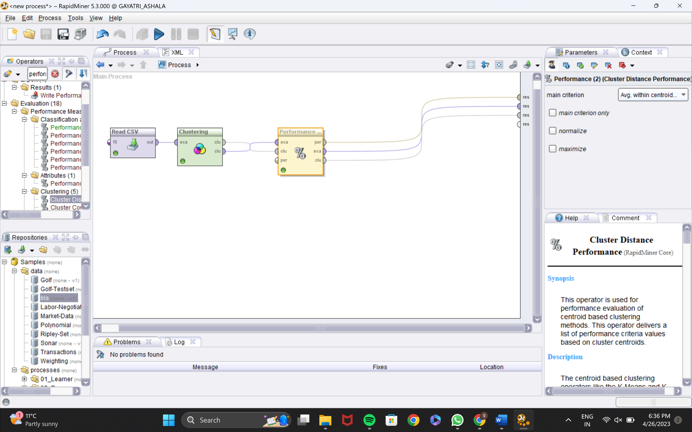
PROCESS

Slide 23
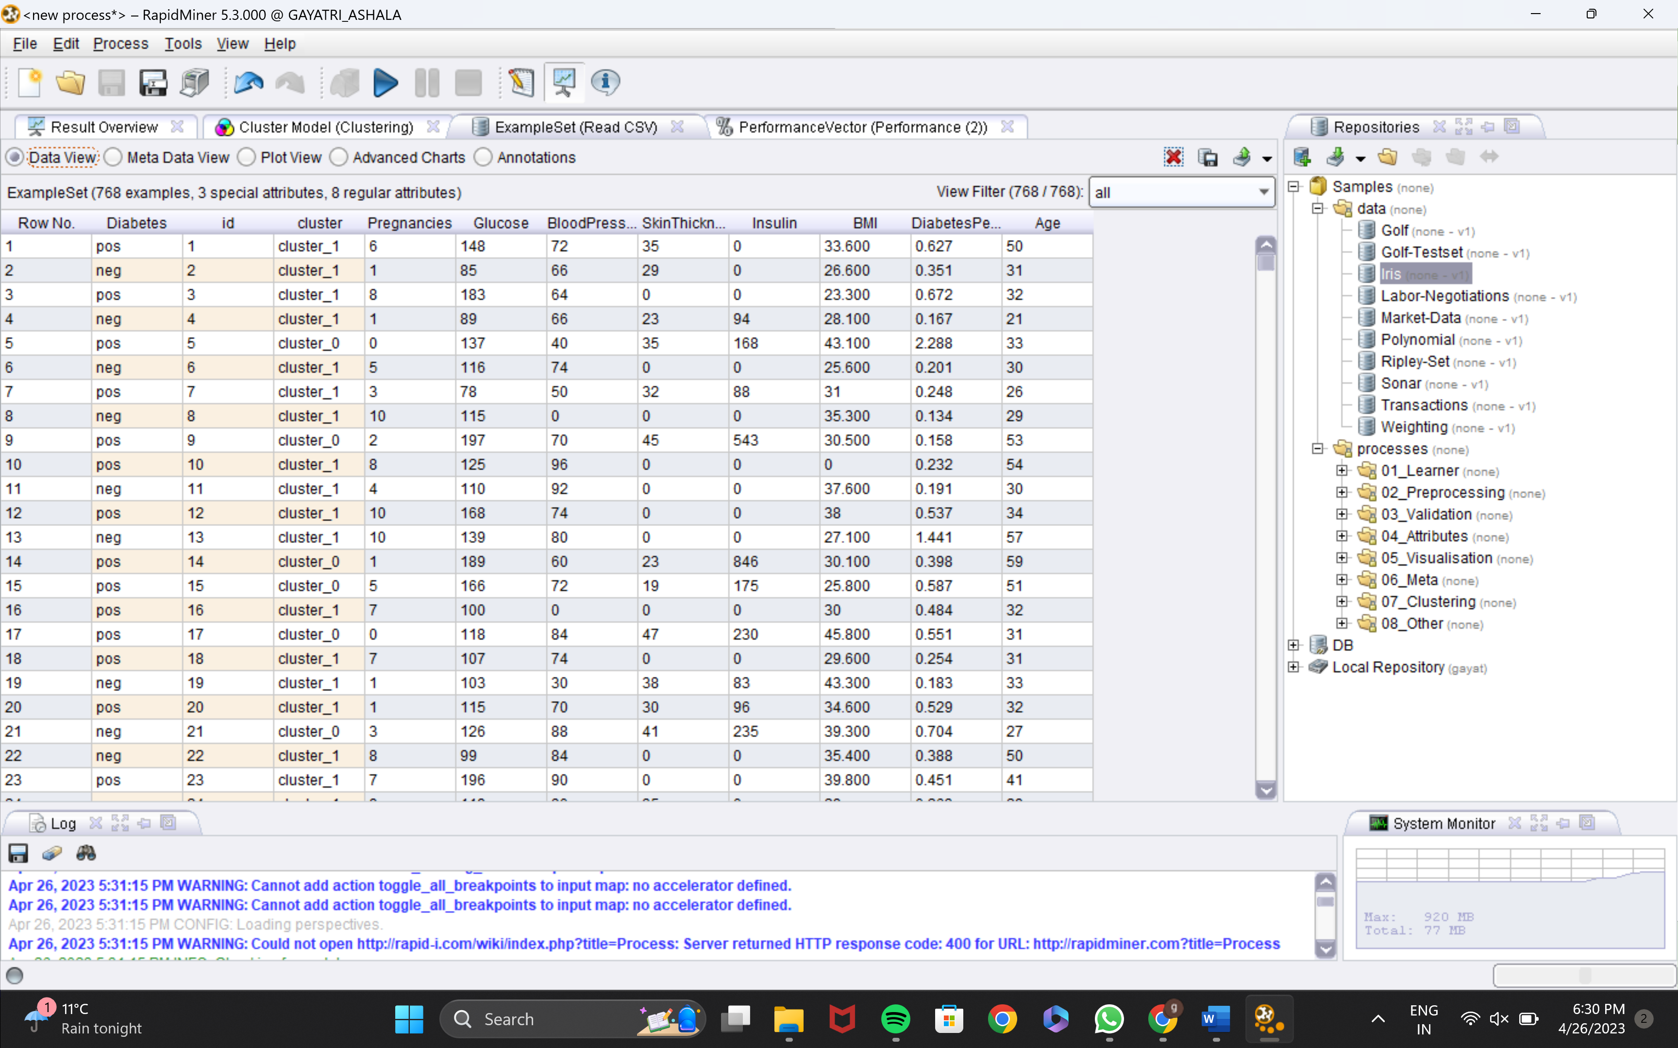
EXAMPLE SET

Slide 24
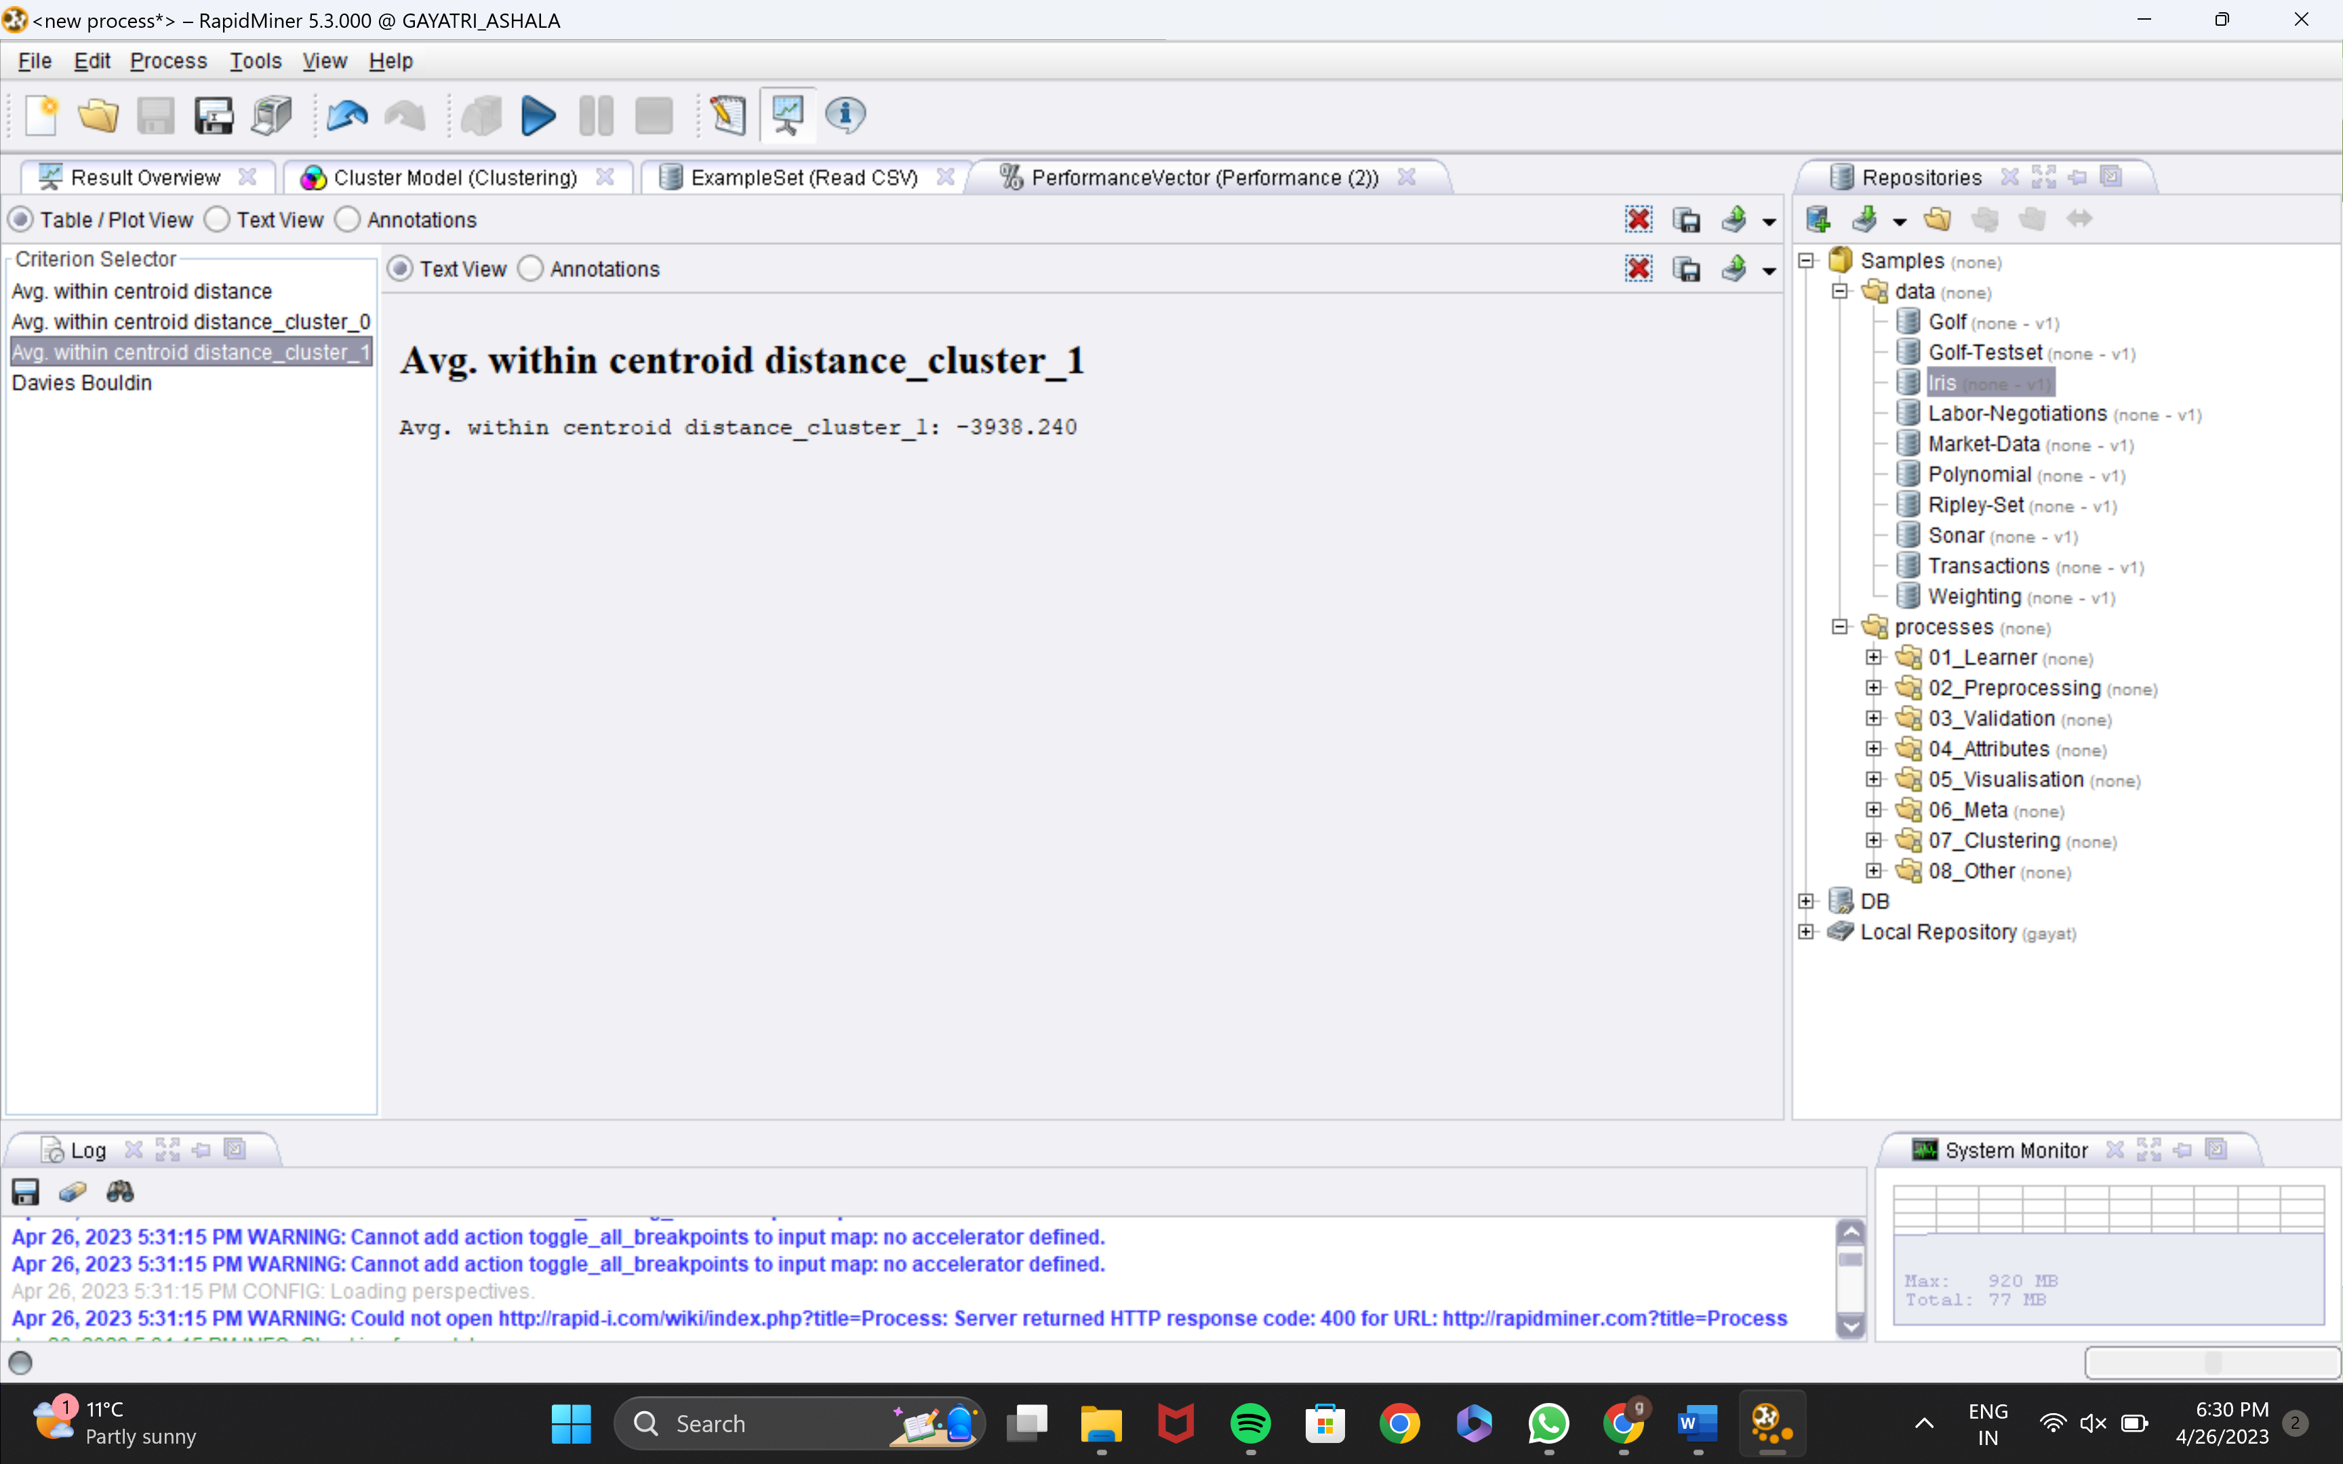
PERFORMANCE

Slide 25
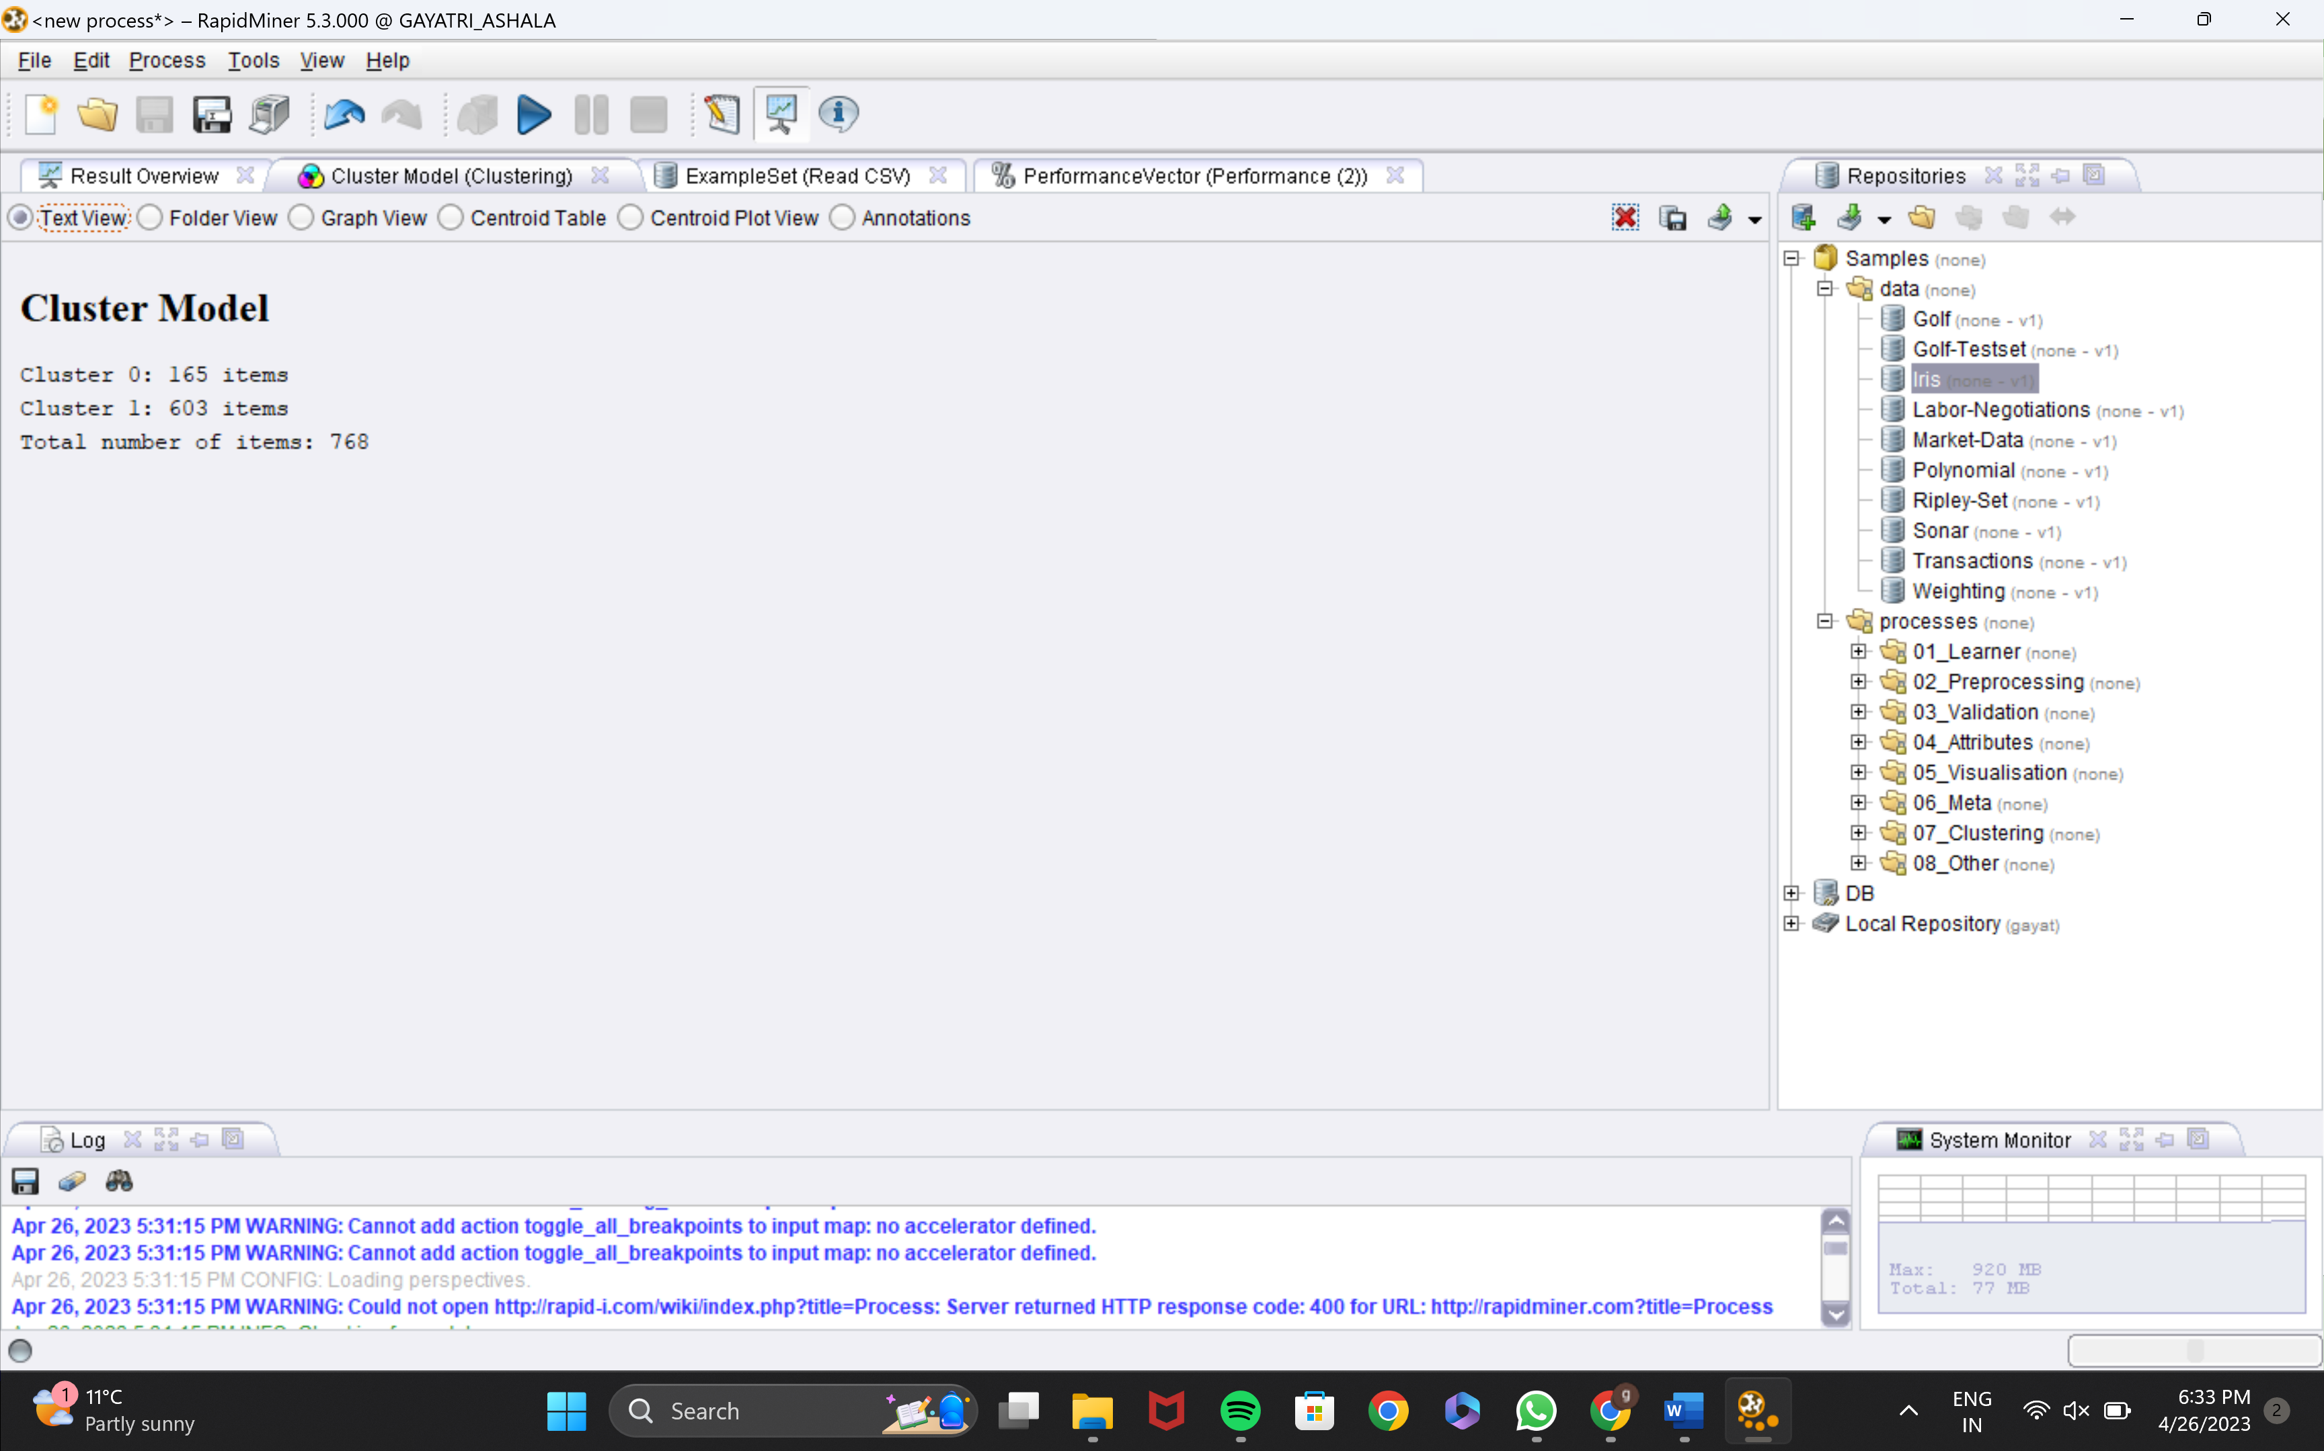
CLUSTER MODEL

Slide 26
NAIVE BAYES
Naive Bayes indicates the features are conditionally independent, which means that the presence or lack of one feature has no effect on the presence or absence of other features.
The process of calculating is simplified since the joint probability of all characteristics may be stated as the product of individual feature probabilities. Because it can be trained rapidly and only a modest amount of training data, Naive Bayes is very effective when dealing with huge feature spaces. It is most commonly used in text classification tasks like filtering out spam and sentiment analysis, but it may also be used to other forms of data.

Slide 27
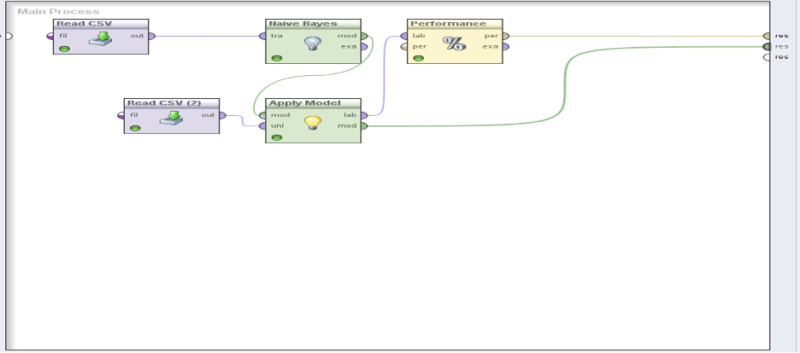
PROCESS

Slide 28
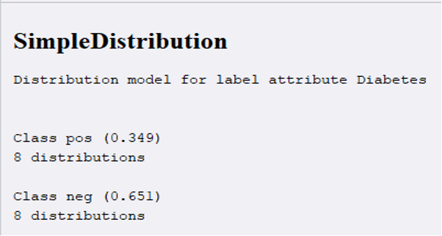
MODEL

Slide 29
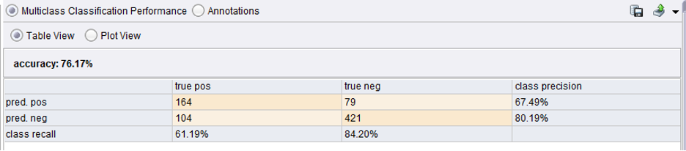
PERFORMANCE

Slide 30
SUPPORT VECTOR MACHINES
It is a powerful algorithm that has been very successful in applications ranging from pattern recognition to text mining.
It works on the principle of fitting a boundary to a region of points that are all alike (that is, belong to one class).
Once a boundary is fitted (on the training sample), for any new points (test sample) that need to be classified, we must simply check whether they lie inside the boundary or not
The advantage of an SVM is that once a boundary is established, most of the training data is redundant.
A core set of points that can help identify and fix the boundary. These data points are called support vectors because they “support” the boundary.
The boundary is traditionally called a hyperplane.

Slide 31
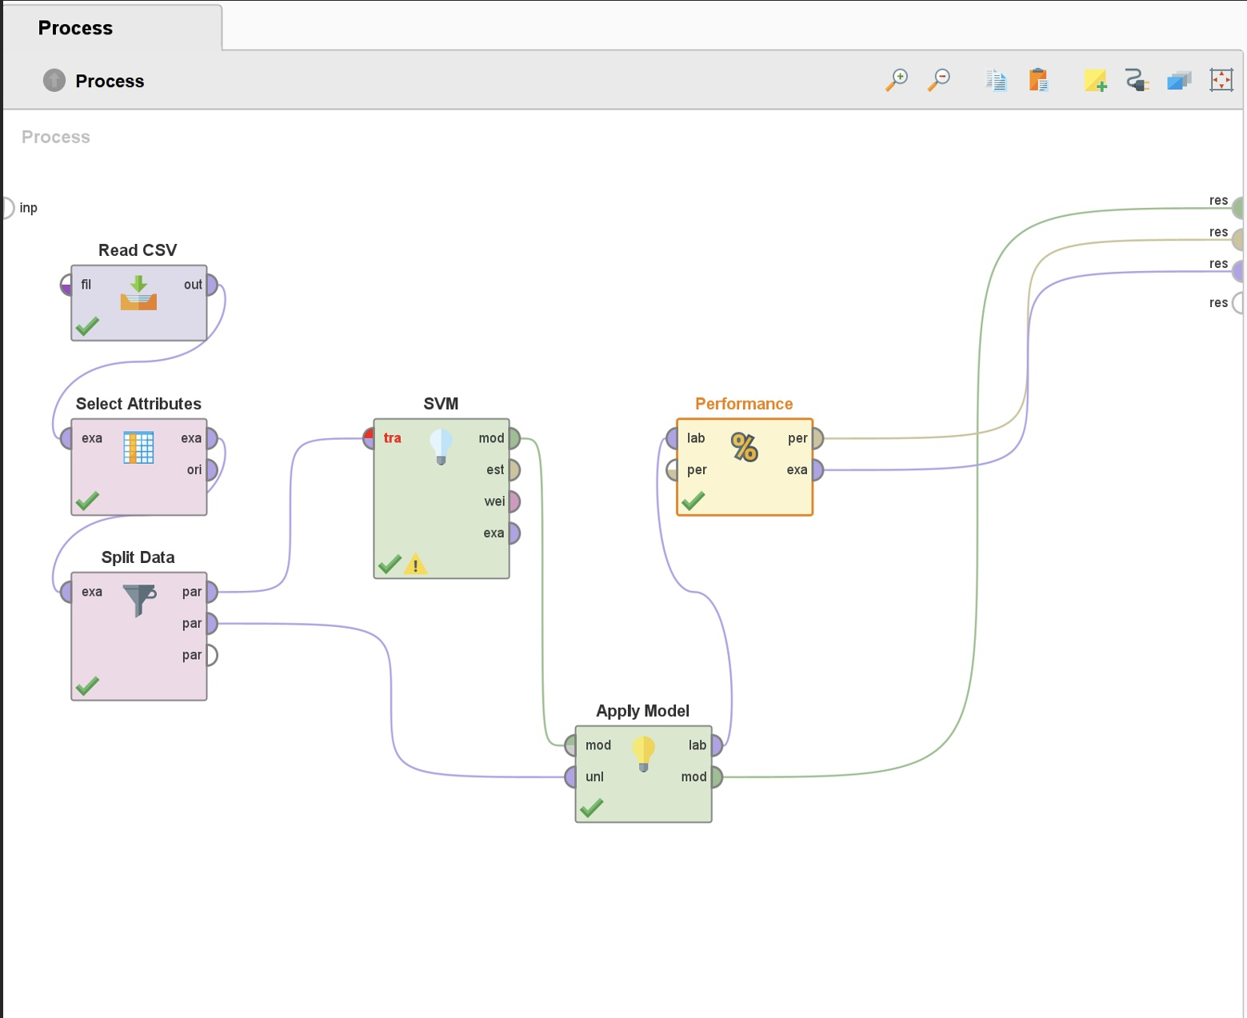
PROCESS

Slide 32
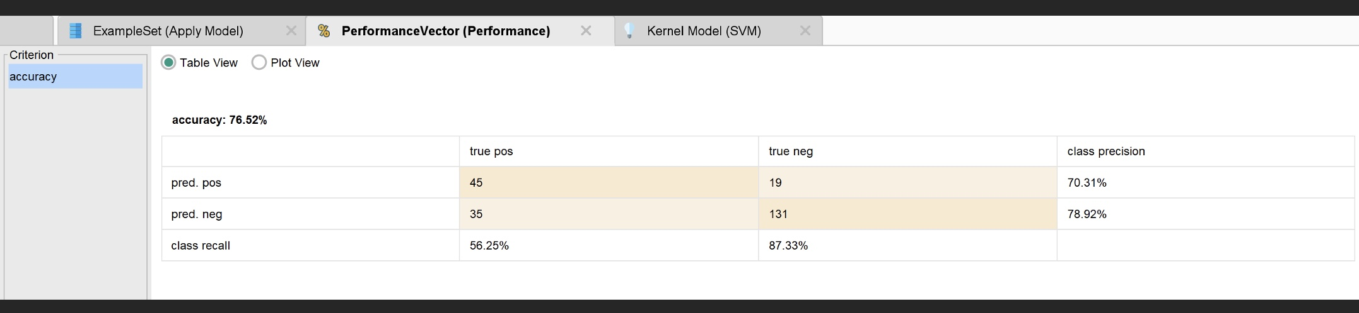
PERFORMANCE

Slide 33
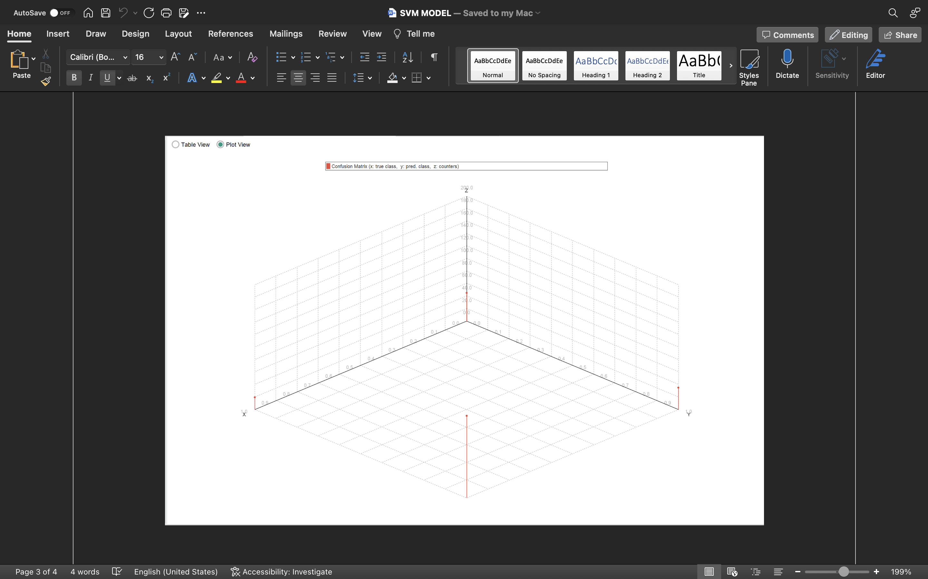
PLOT VIEW

Slide 34
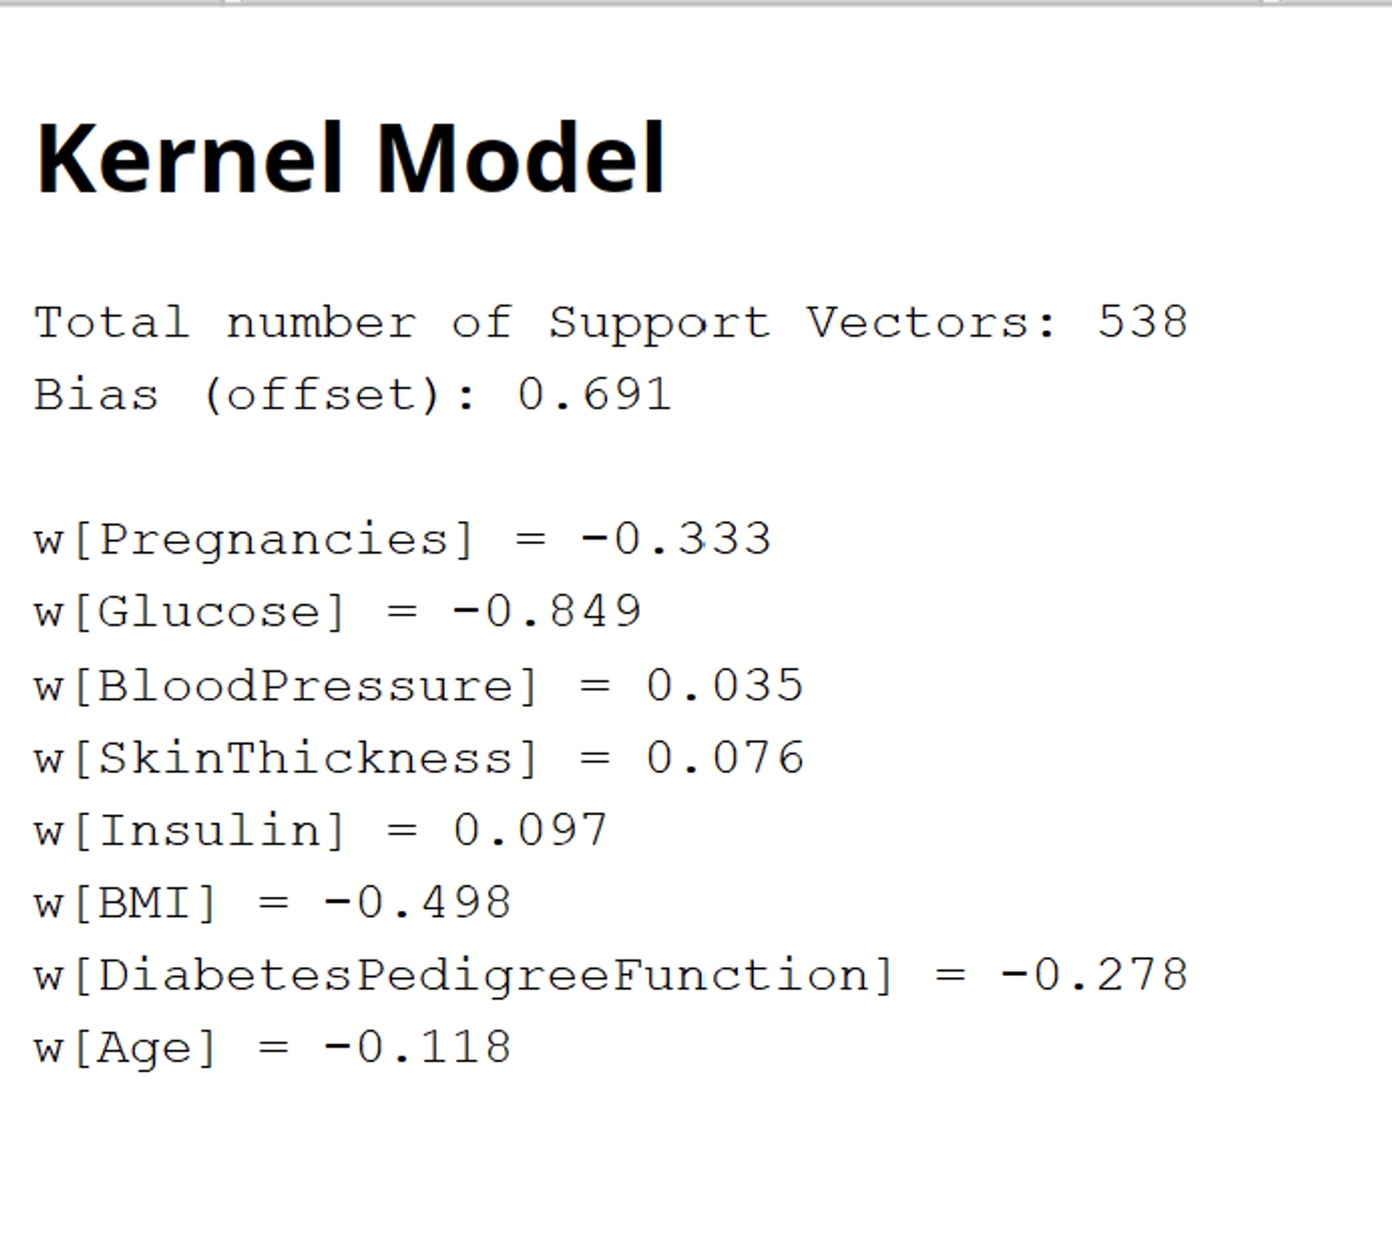
KERNEL MODEL

Slide 35
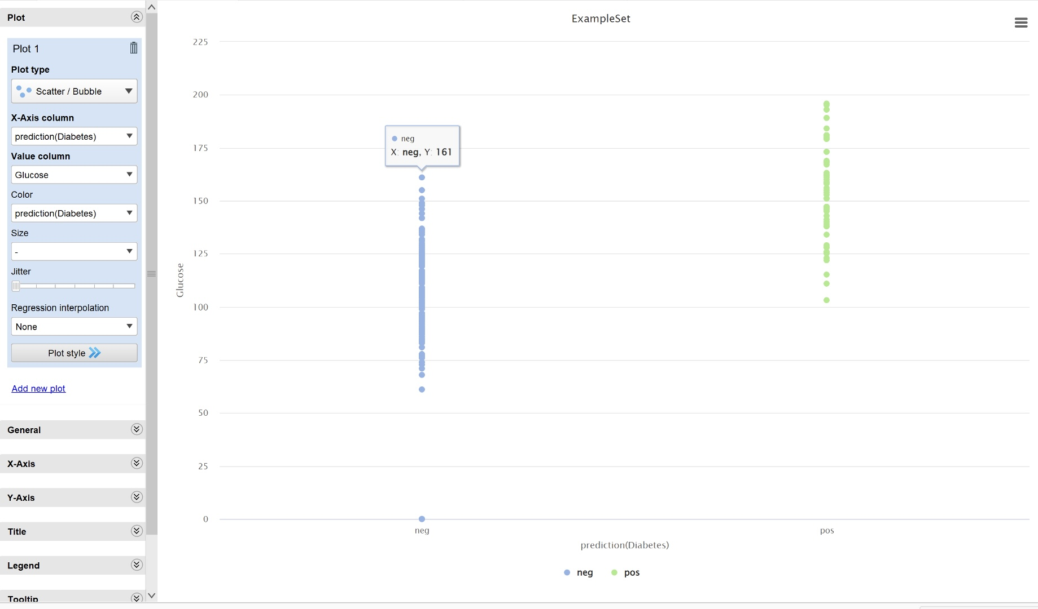
GRAPH

Slide 36
K-NEAREST NEIGHBOUR
The k-NN model requires normalization to avoid any bias by any attribute that has large or small units in the scale. The model is quite robust when there is any missing attribute value in the test record. If the value in the test record is missing, the entire attribute is ignored in the model, and still the model can function with reasonable accuracy. In the implementation example, if the sepal length of a test record is not known, then the sepal length is ignored in the model. When an attribute value is missing, k-NN becomes a three-dimensional model instead of the regular four dimensions.
The Apply Model operator takes the test data and applies the k-NN model to predict the class type of the species. The Performance operator is then used to compare the predicted class with the labeled class for all of the test records.

Slide 37
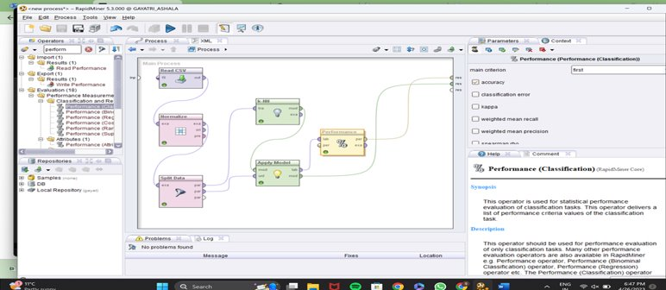
PROCESS

Slide 38
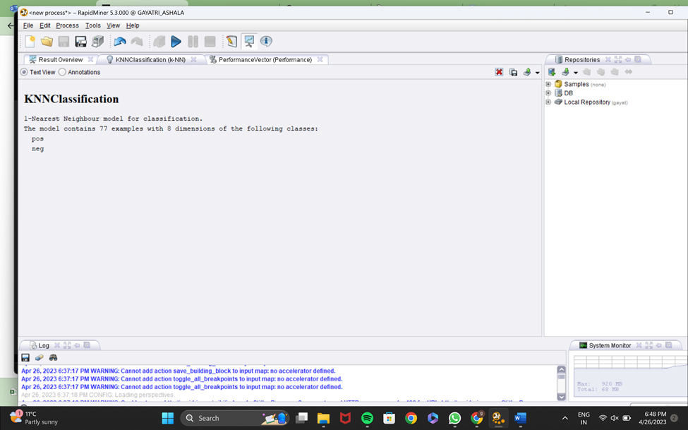
K-NN

Slide 39
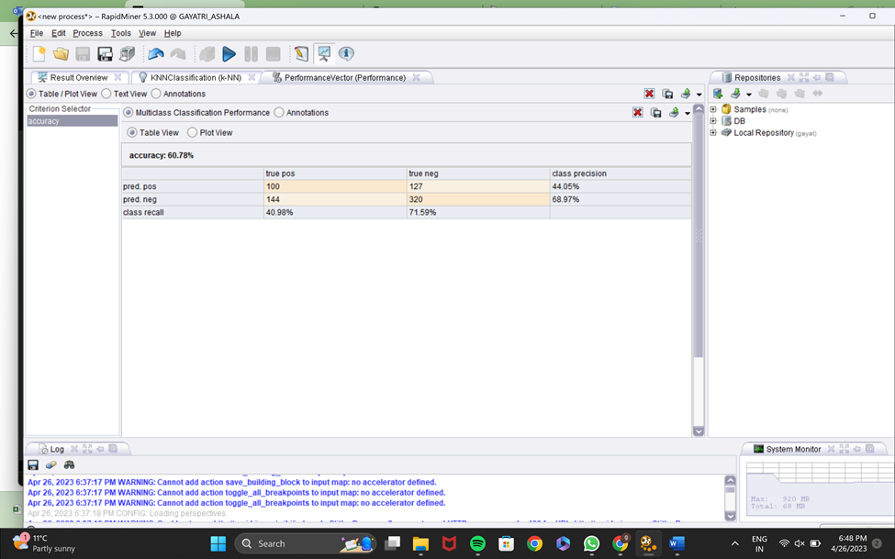
PERFORMANCE VECTOR

Slide 40
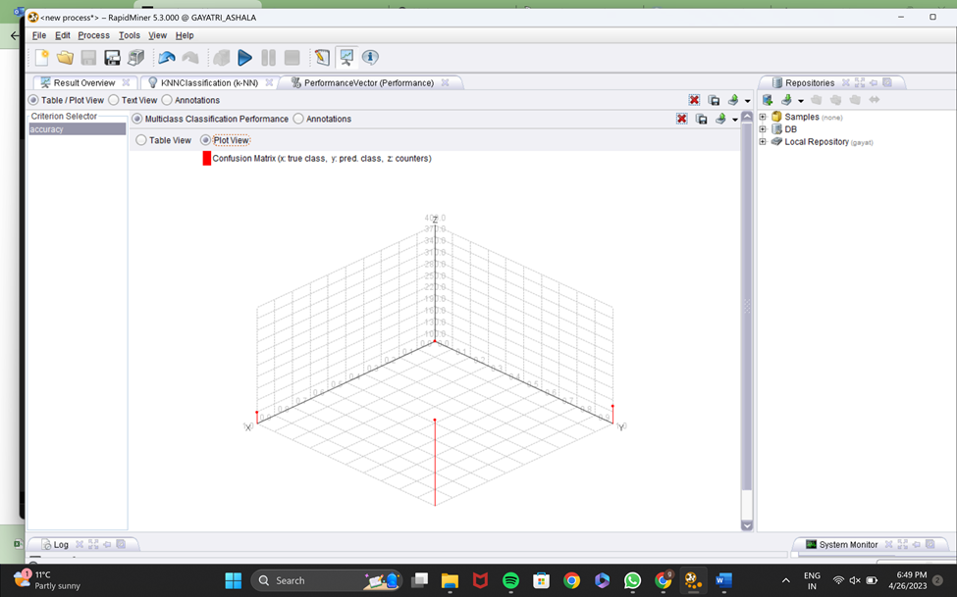

Slide 41
MODEL EVALUATION
We will now see how to build a decision tree model on this data. As mentioned , the Validation operator allows us to build a model and apply it on validation data in the same step. This means that two operations—model building and model evaluation—must be configured using the same operator.

Slide 42
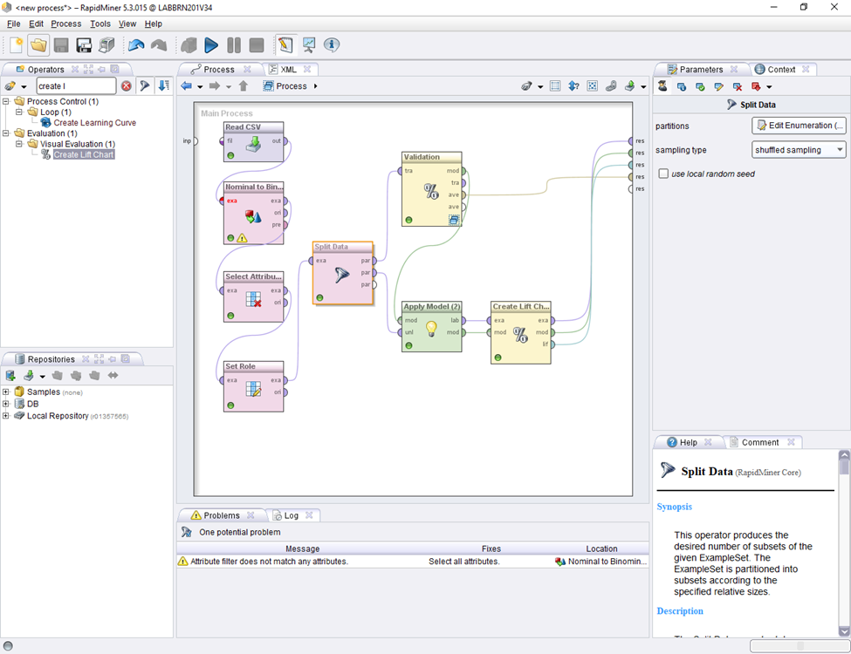
PROCESS

Slide 43
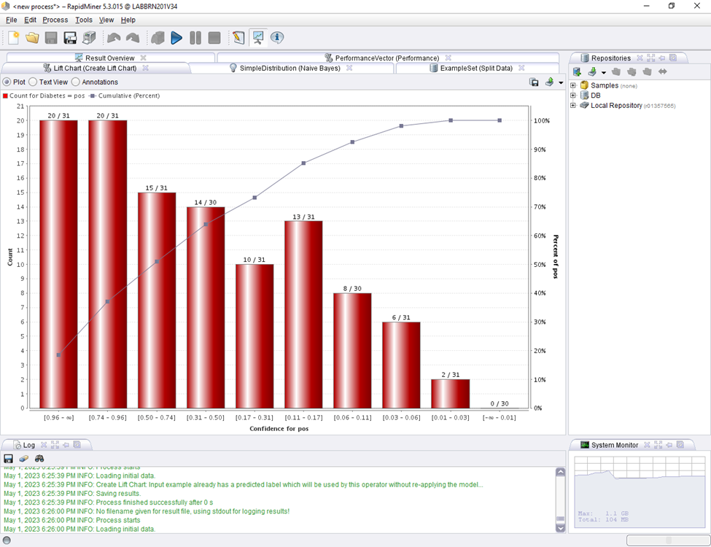
LIFT CHART

Slide 44
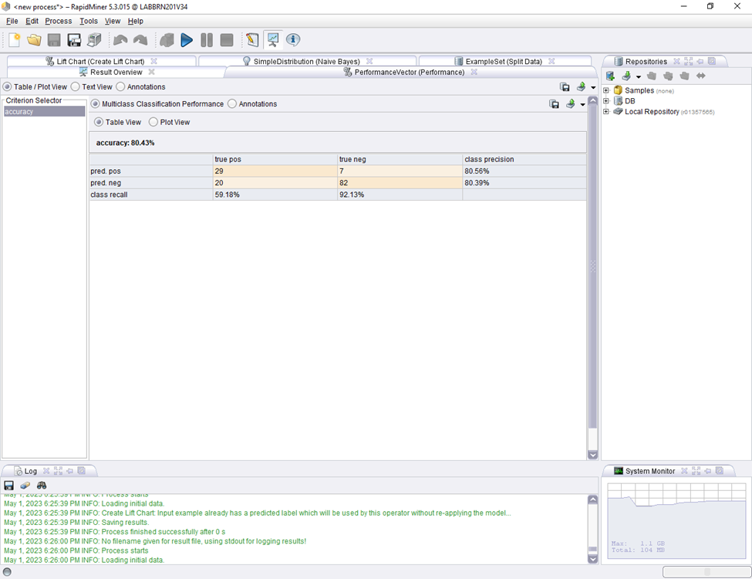
PERFORMANCE VECTOR

Slide 45
ARTIFICIAL NEURAL NETWORK (A-NN)
ANN models frequently have numerous layers of neurons. The issue domain's raw data is sent to the first layer, sometimes referred to as the input layer. The following layers, referred to as the hidden layers, carry out intricate calculations on the incoming data. The computation's results are then produced by the output layer.
Each neuron in the ANN gets input from a single neuron or multiple neurons in the layer below, processes this input using an activation function, and then sends the output to a single neuron or multiple neurons in the layer above. During the training process, the weights and biases of the connections between the neurons are modified to enhance the model's performance.
Natural language processing, picture and speech recognition, financial forecasting, and many more fields make use of ANNs. They may understand intricate correlations between input and output data without explicit programming because of their tremendous adaptability.

Slide 46
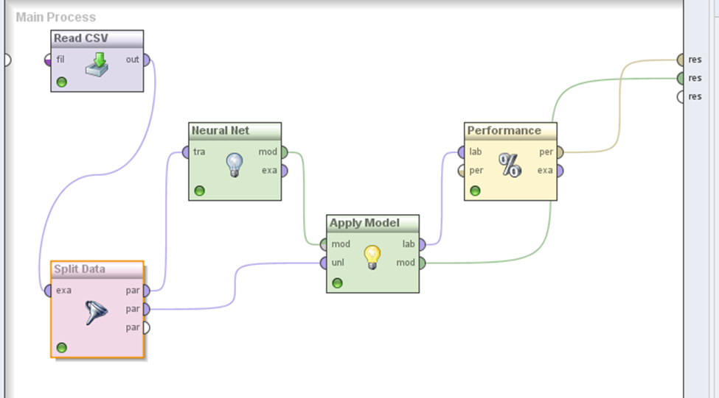
PROCESS

Slide 47
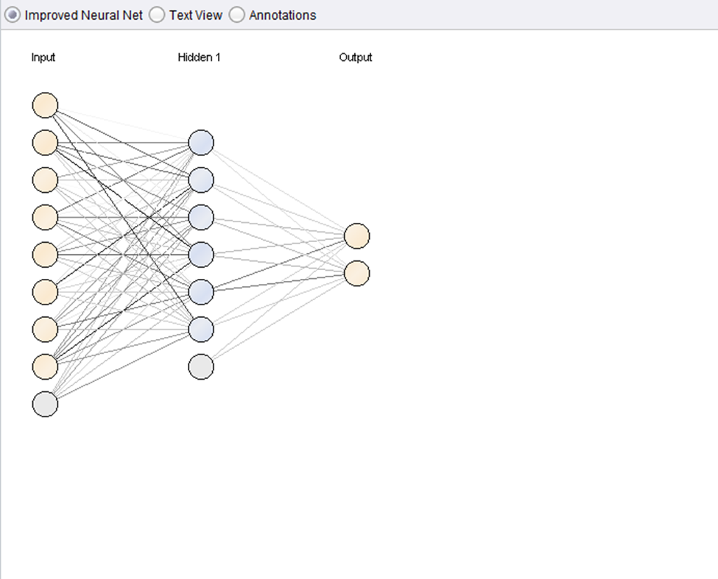
NEURAL NETWORK

Slide 48
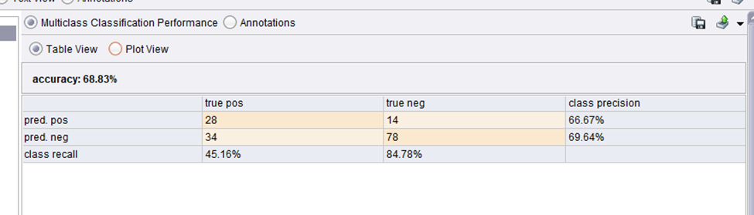
PERFORMANCE

Slide 49
ASSOCIATION ANALYSIS
Association analysis is the task of finding interesting relationships in large datasets. These interesting relationships can take two forms: frequent item sets or association rules. Frequent item sets are a collection of items that frequently occur together.
Using this model we are going to predict the diabetics in pregnant women.
In association analysis, a collection of zero or more items is termed an itemset. If an itemset contains k items, it is called a k-itemset. For instance, {Diabetics, Age, Pregnant Women} is an example of a 3-itemset. The null (or empty) set is an itemset that does not contain any items.

Slide 50
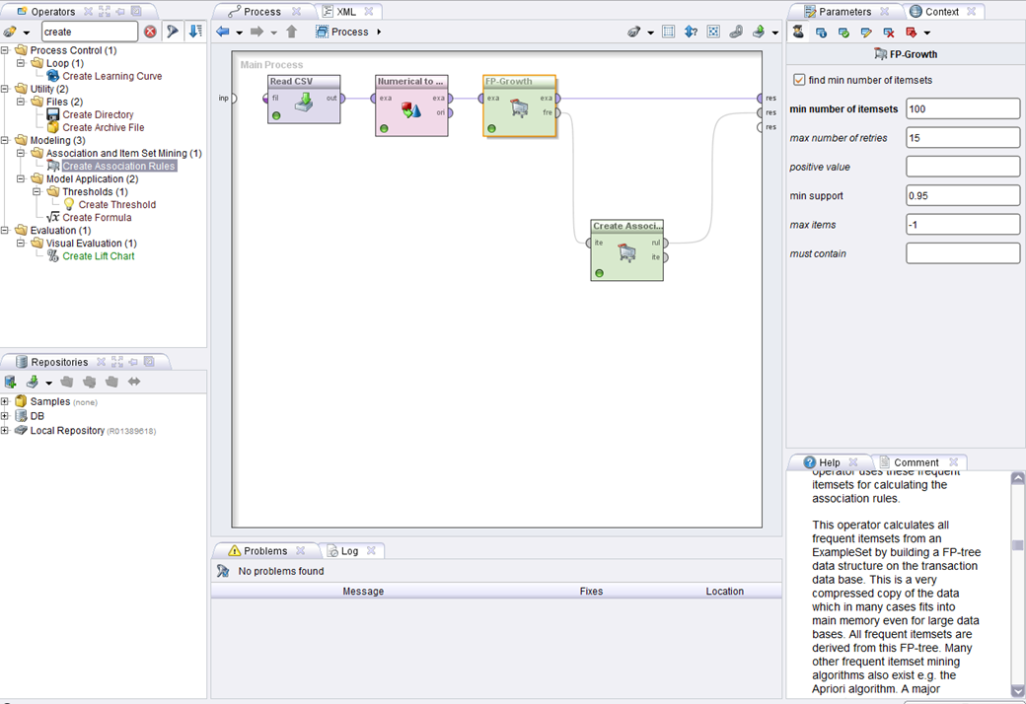
PROCESS

Slide 51
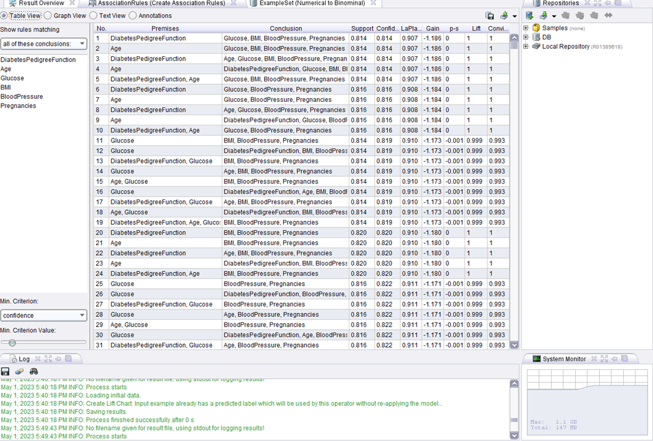
TABLE

Slide 52
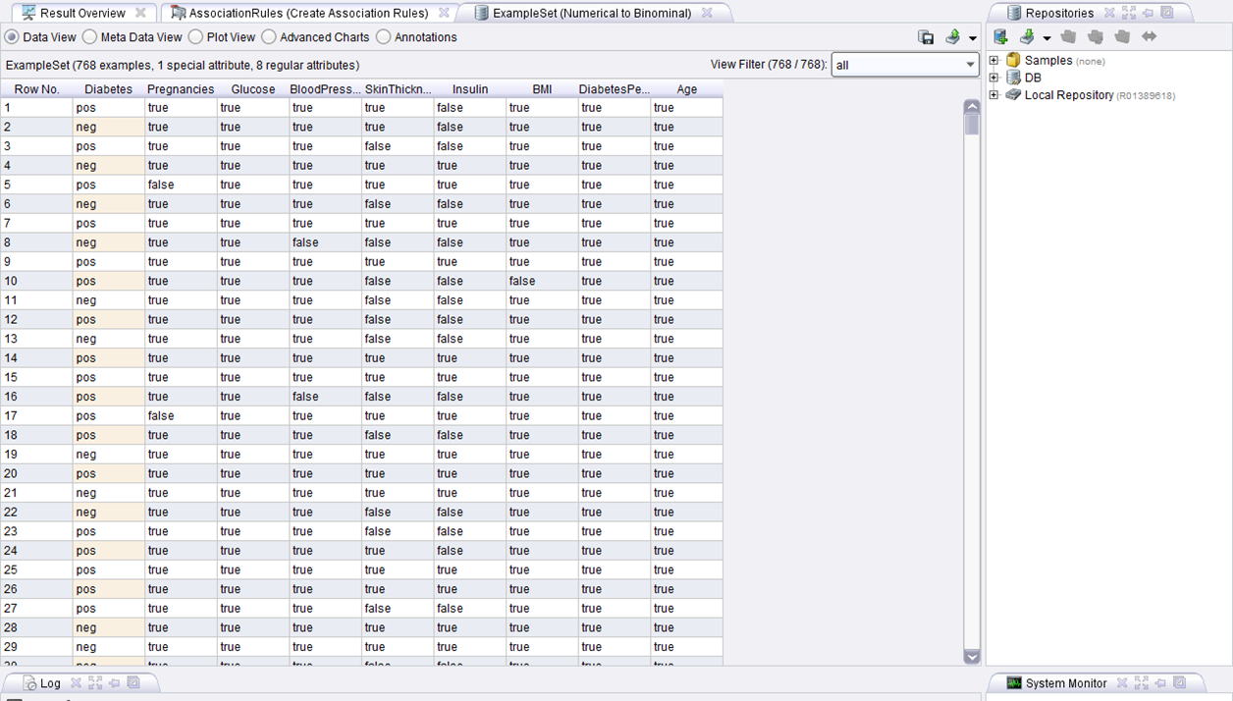
EXAMPLE SET

Slide 53
CONCLUSION
The best accuracy we got in the algorithms so far is 80.43% which is in model evaluation and the least in KNN which has 60.78%. All the algorithms are being performed in Rapid Miner.

